Slide 1
Thermo Fusion and Eclipse TMT data for human platelets
Phillip Wilmarth
OHSU Proteomics Core
May 17, 2020
Notes:
Analysis of an 11-plex TMT labeled human platelet sample from OHSU Proteomics Core. Two-hour LC runs performed at OHSU for Fusion and at Thermo Finnegan in San Jose, CA for Eclipse.

Slide 2
Human platelet TMT-labeled samples
HOWA-846_TMTExp1_Norm samples
1-hour incubations with 3 anti-coagulants – 3 bio replicates each
2 identical reference channels
11-plex TMT reagents
Sample originally run on Thermo Fusion instrument at OHSU
New runs on Thermo Eclipse at Thermo in San Jose
Usual SPS-MS3 method
SPS-MS3 using real-time search (RTS)
Runs with and without FAIMS
Notes:
The human platelet samples were prepared by Dr. Ashok Reddy and analyzed at Thermo by Joshua Nicklay. The new data was collected on an Eclipse Oribtrap Tribrid using the SPS MS3 method in combination with real-time search (RTS) and with a FAIMS front end. Sample loading and a 2-hour reverse phase gradient was used to mimic original data generated at OHSU using our older Thermo Fusion Tribrid instrument. The new data was a simple SPS MS3 run (similar to what the Fusion can do). There was also a run using the real-time search acquisition mode (RTS) to see if better sensitivity could be obtained. Both plain SPS MS3 and RTS SPS MS3 were also done with and without front end FAIMS filtering (that data is not presented here).

Slide 3
Analysis using Comet/PAW pipeline
Open source available at https://github.com/pwilmart/PAW_pipeline
Uses Comet search engine
Very sensitive and optimized for TMT
Wide tolerance search of human canonical reference protein DB
Accurate mass conditional score histograms using target/decoy
Peptide Spectrum Matches (PSMs) filtered to 1% FDR
Notes:
The 5 RAW files were processed at San Jose using Proteome Discoverer (results not shared). The RAW files were also processed at OHSU using the Comet/PAW pipeline.

Slide 4
The five 2-hour runs combined for filtering
Each Eclipse run was done with a 2-hour gradient similar to original Fusion run
Deltamass and conditional score histograms done for all 5 runs
Accurate mass window locations and score thresholds set interactively
Scores are a PeptideProphet-like discriminant function
Notes:
The Comet/PAW pipeline uses Comet for the database searching. Post search processing and FDR analysis is done with a series of Python scripts in the PAW pipeline. Accurate mass measurements from the high resolution Oribitraps are used correctly to increase PSM identification sensitivity. A discriminant score transformation, similar to PeptideProphet, and the target/decoy method are used as an efficient static classifier for correct and incorrect matches. Basic and extended parsimony principles are used to provide the best context for quantitative analysis from shotgun proteomics data. TMT reporter ions are extracted and aggregated in ways that facilitate proper normalization and maximize quantitative information.

Slide 5
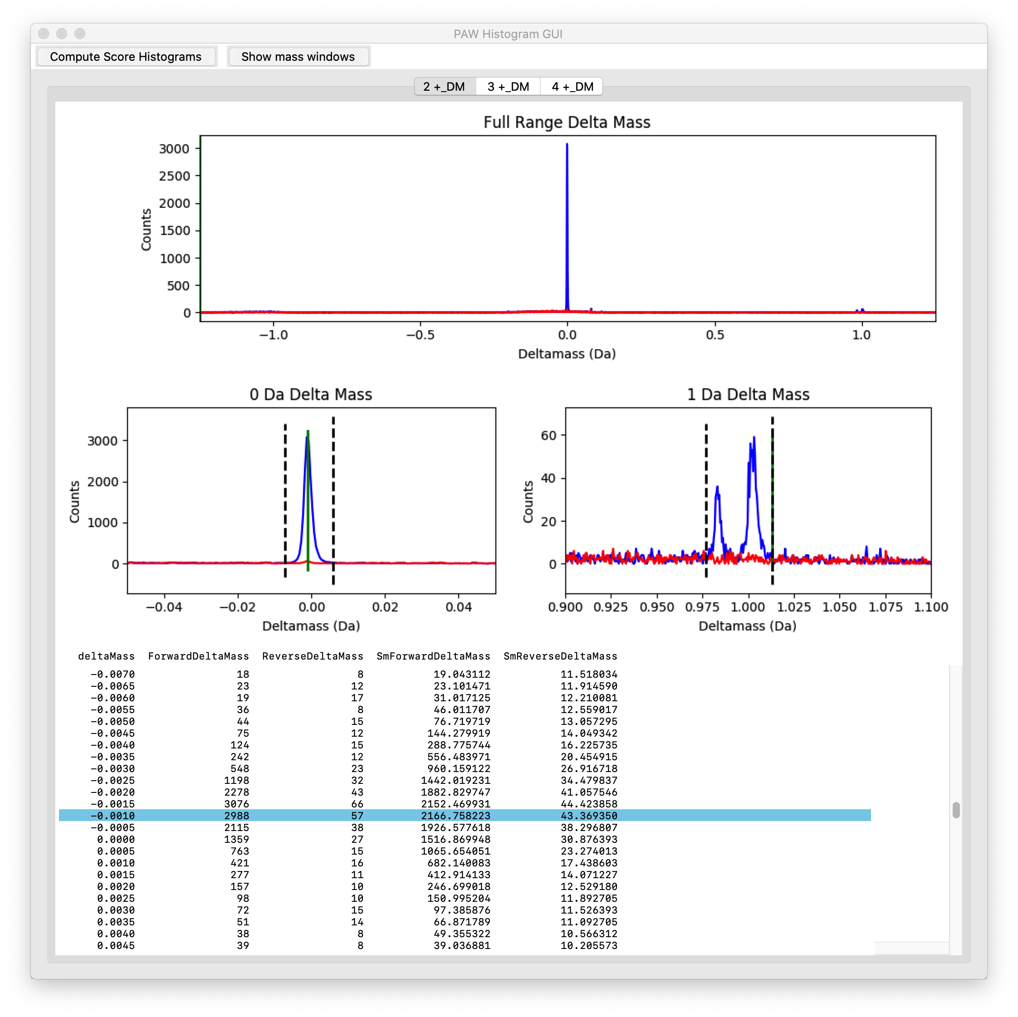
2+ PSMs – deltamass histograms
Target (blue), decoy (red)
Narrow window at 0-Da
Narrow window at 1-Da
Deamidation at 0.984
C13 mis-trigger at 1.0003
Also all other deltamasses
Notes:
Accurate mass differences between measured MH+ values and the calculated MH+ values from the top PSM matches are histogrammed from wide tolerance searches (typically 1.25 Da). Most correct matches (blue histograms) are concentrated in a peak at 0-Da. There are smaller peaks at 0.984 Da (deamidation) and 1.003 Da (first isotopic peak). Narrow windows to capture the single peak at 0-Da and the two peaks at 1-Da are set. Those define two peptide deltamass classes. All other deltamasses not in inside the two narrow windows make up the third deltamass class. These are the histograms and the window settings for the 2+ matches. The deltamasses for decoy matches are the red histograms.

Slide 6
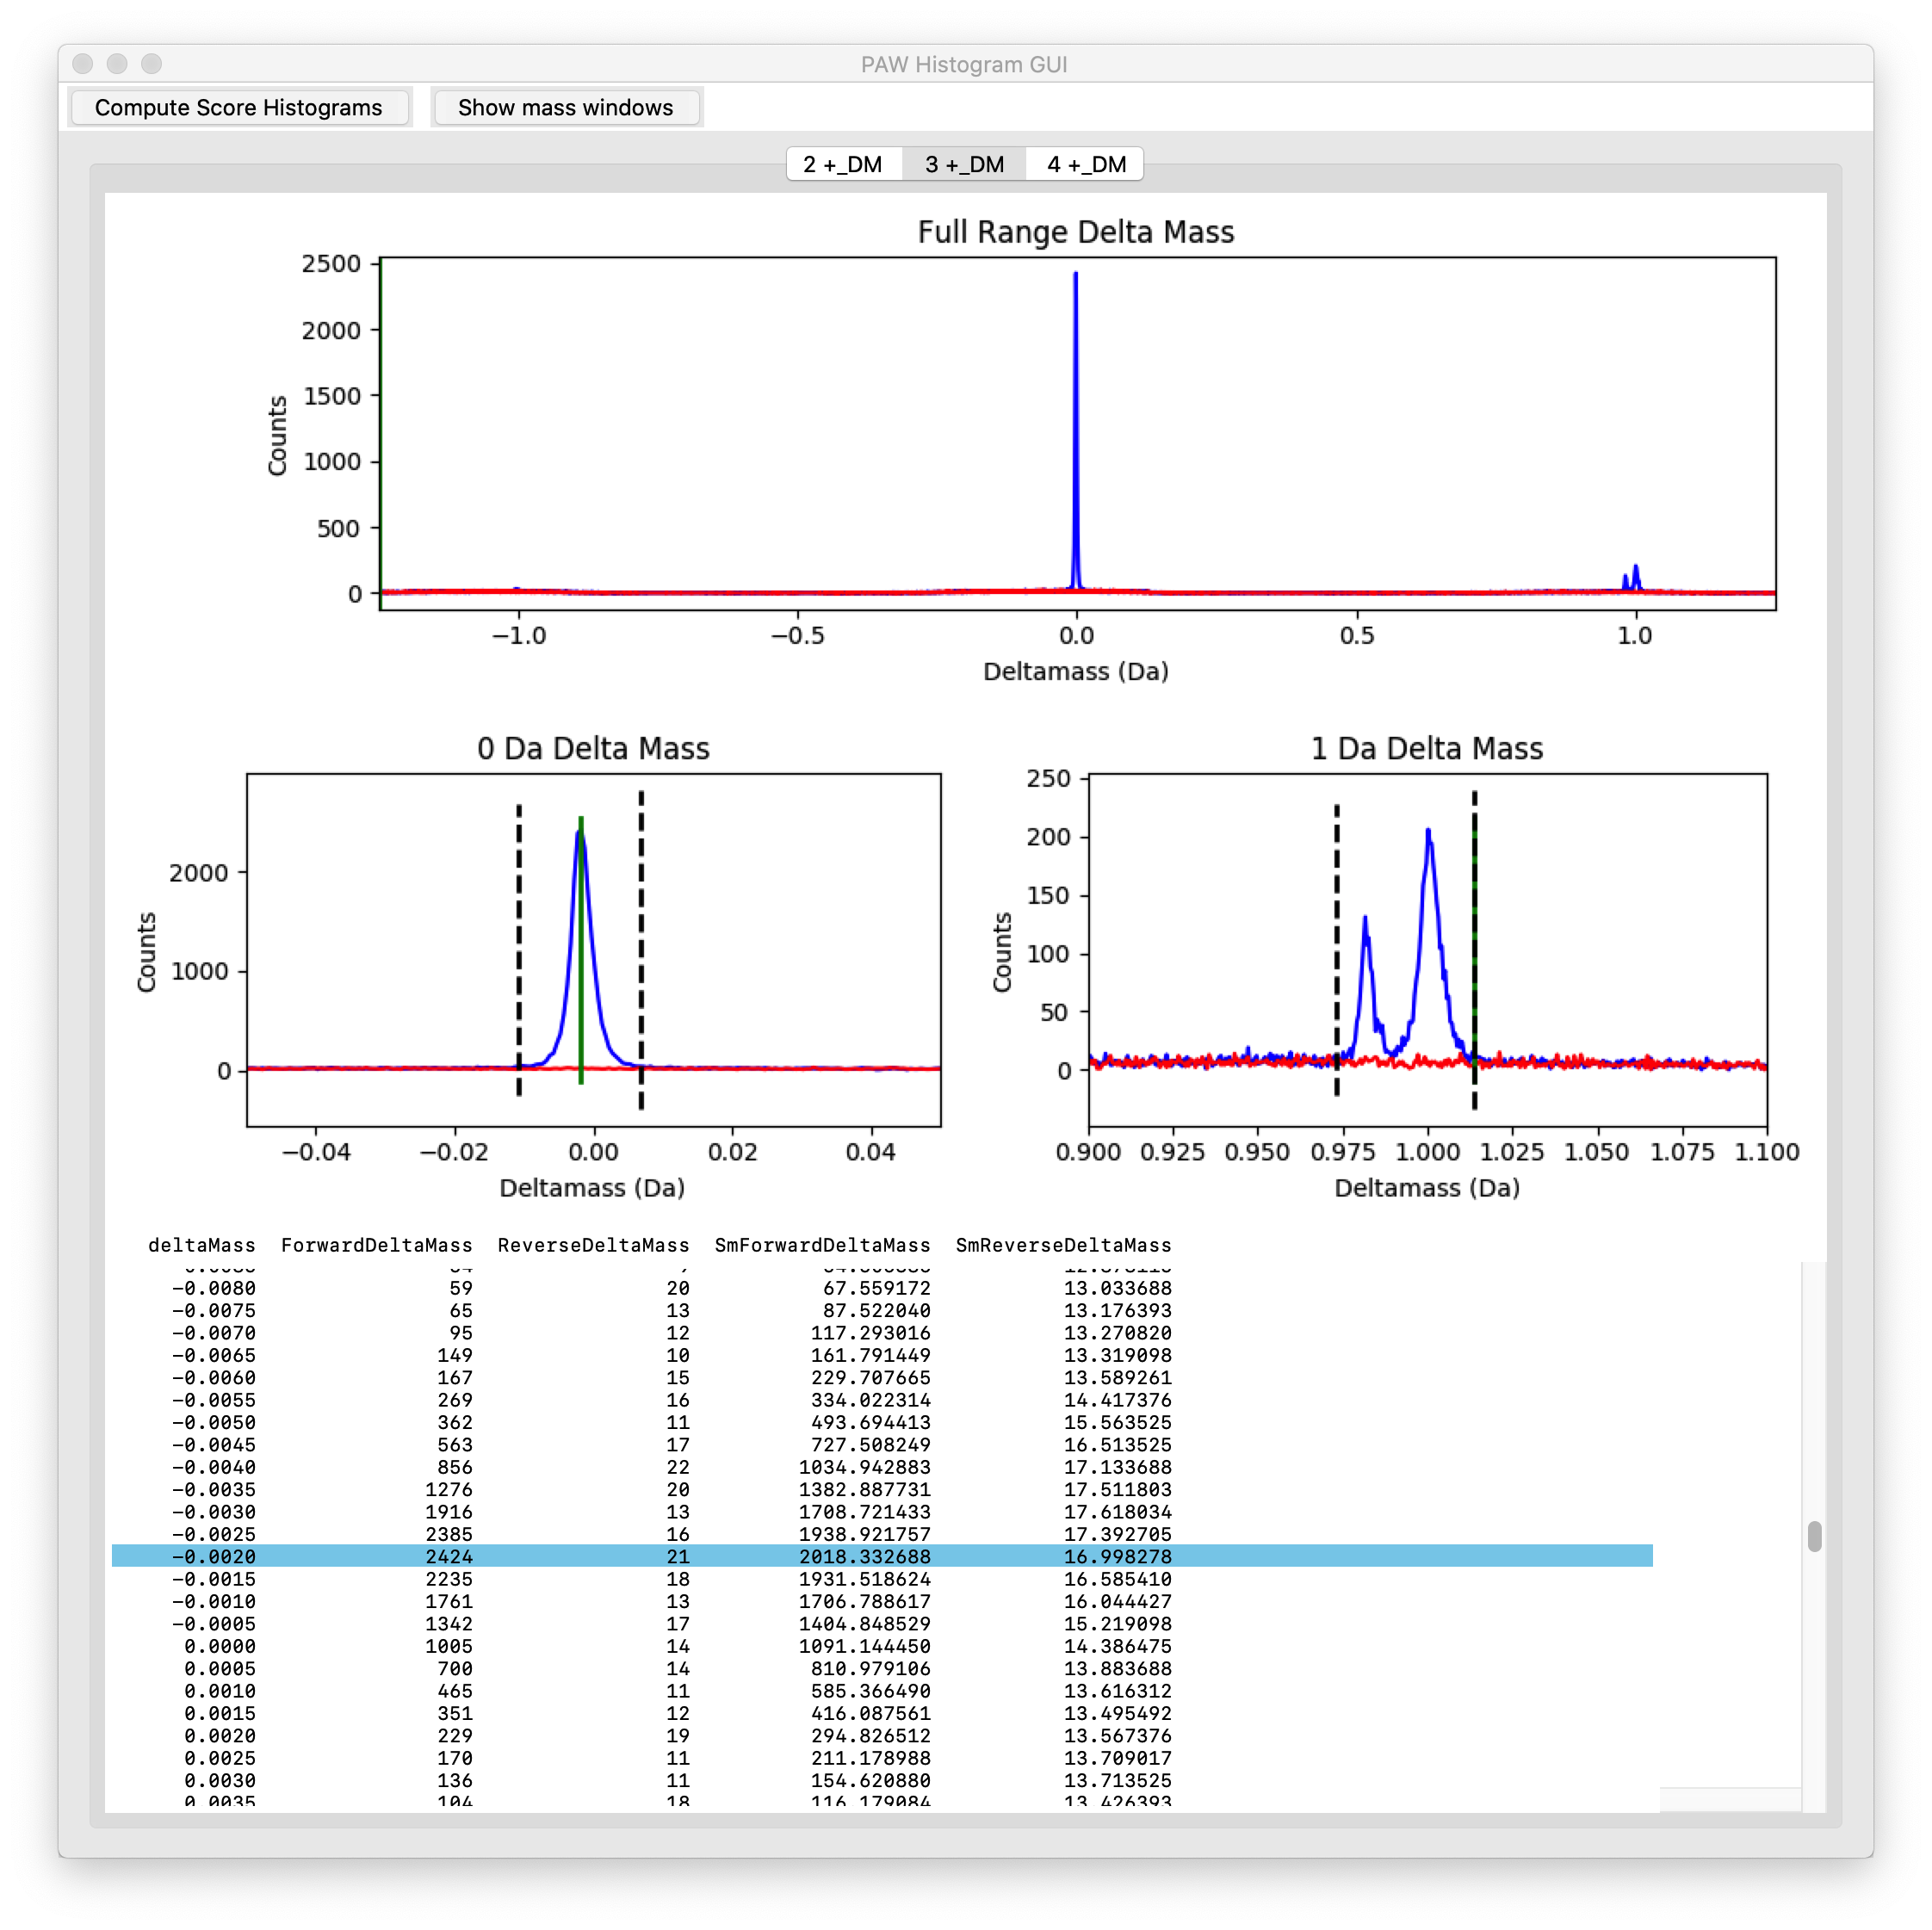
3+ PSMs – deltamass histograms
Target (blue), decoy (red)
Narrow window at 0-Da
Narrow window at 1-Da
Deamidation at 0.984
C13 mis-trigger at 1.0003
Also all other deltamasses
Notes:
These are similar histograms and windows for the 3+ matches.

Slide 7
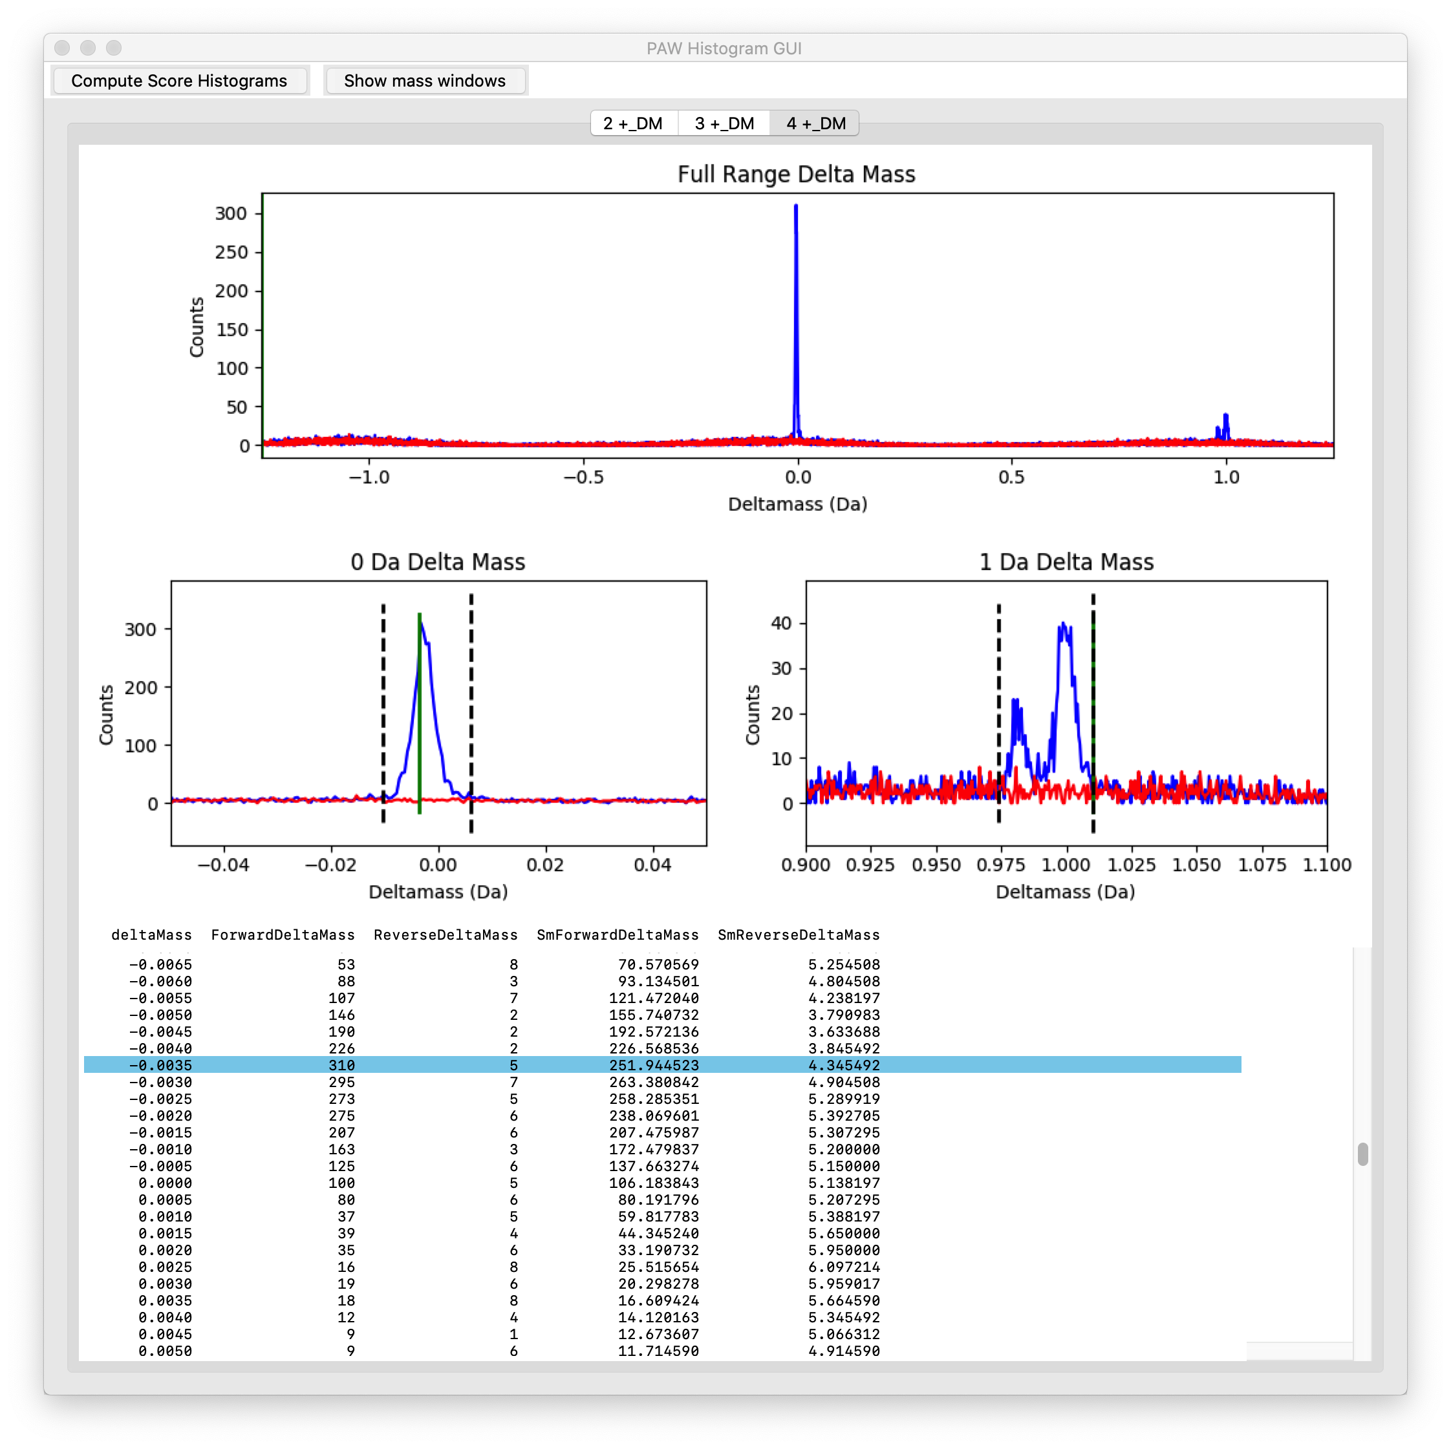
4+ PSMs – deltamass histograms
Target (blue), decoy (red)
Narrow window at 0-Da
Narrow window at 1-Da
Deamidation at 0.984
C13 mis-trigger at 1.0003
Also all other deltamasses
Notes:
These are similar histograms and windows for the 4+ matches.

Slide 8
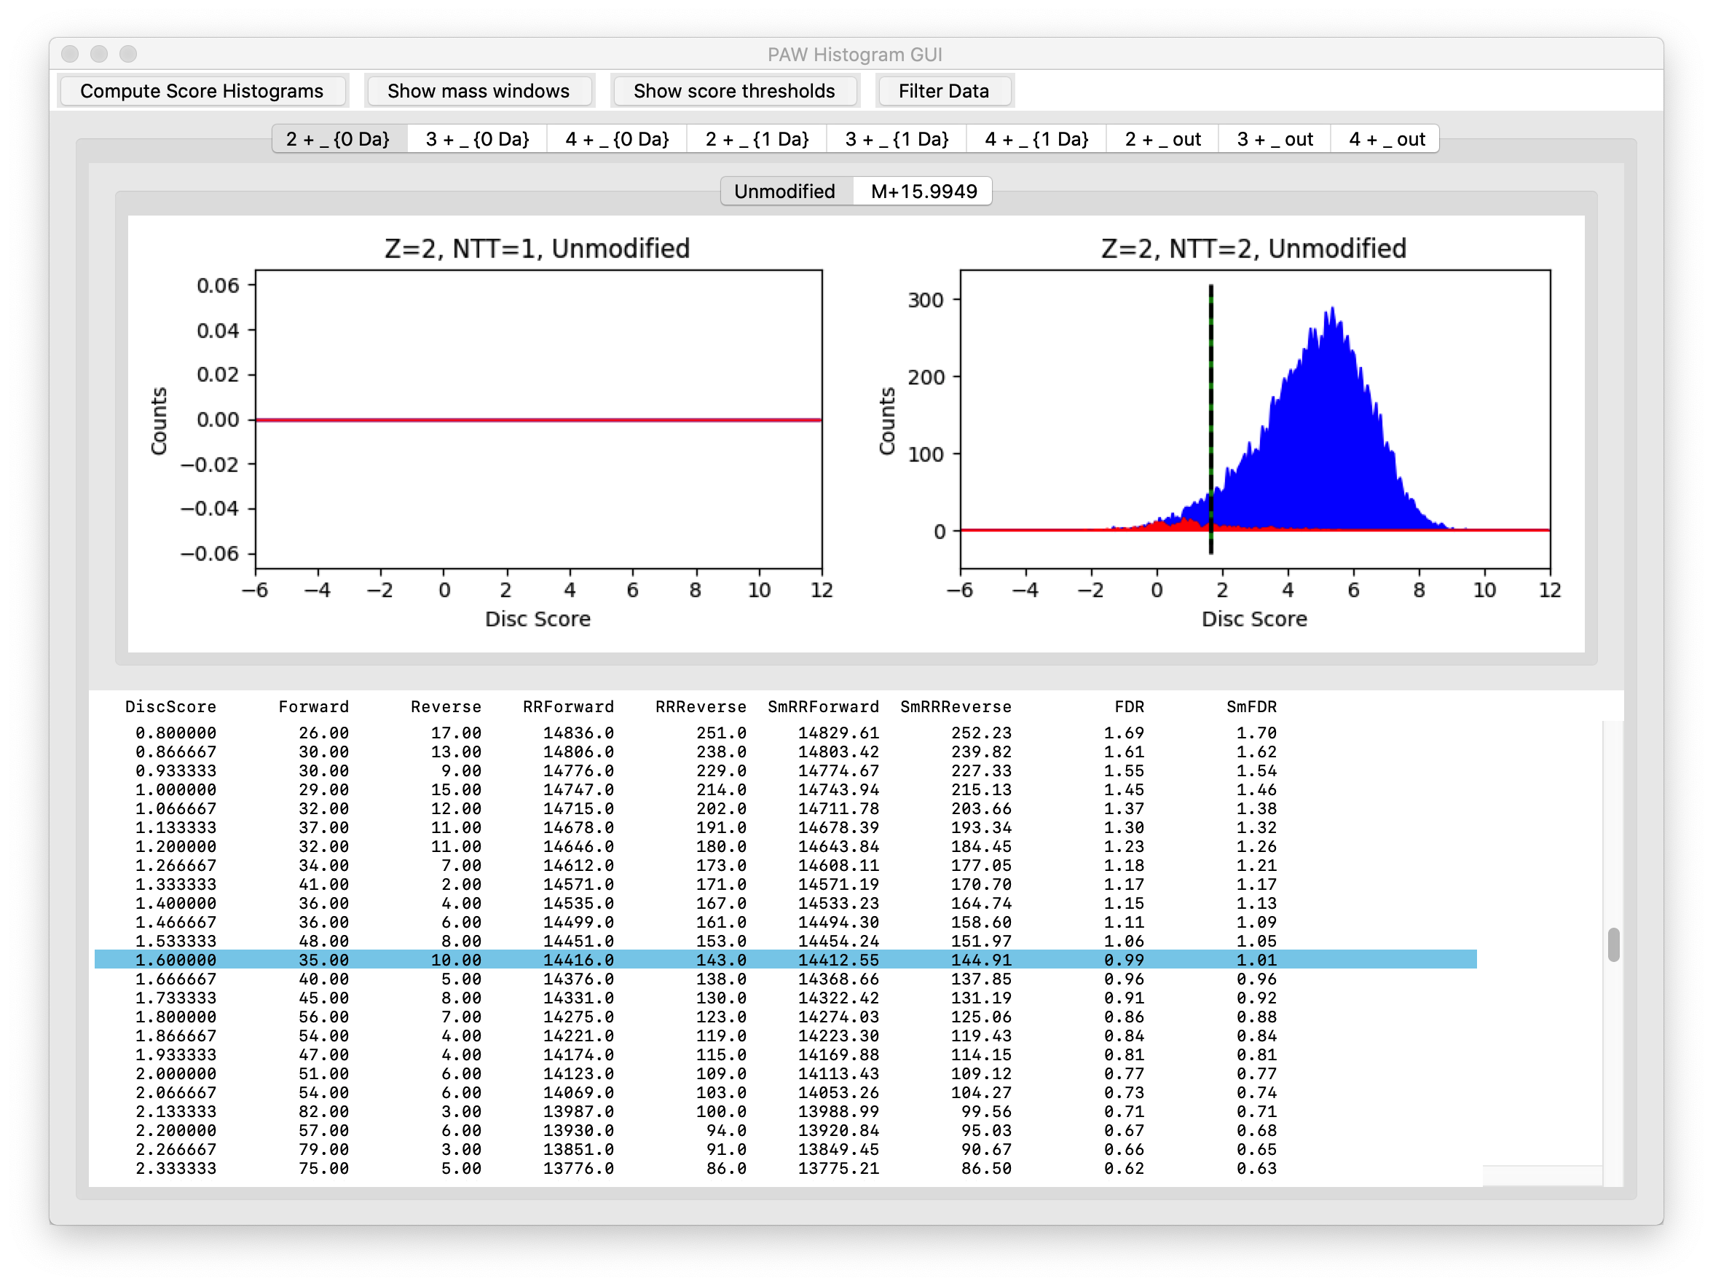
Conditional Scores for 2+
Target (blue), decoy (red)
Dotted line at 1% FDR
0-Da region
Unmodified PSMs
Notes:
The discriminant scores for target matches (blue) and decoy matches (red) are overlaid in conditional score histograms. A table of FDRs as a function of discriminant score is also shown to guide score cutoff (the dotted line) selection to achieve the desired FDR. In addition to the three deltamass classes (0-Da, 1-Da, and outside windows), scores are separated by peptide charge state (2+, 3+, and 4+) and by variable modification state (unmodified peptides and peptides with an oxidized methionine). These are the scores for for the 0-Da deltamass, 2+ charge, unmodified peptides. The dotted line is a 1% FDR cutoff. We have 14,416 target matches above this score cutoff.
There is also another separation by number of tryptic termini (NTT). We specified only fully tryptic peptides for this Comet search, so we do not have any semi-tryptic peptide scores (the left histogram plot window).

Slide 9

Conditional Scores for 2+
Target (blue), decoy (red)
Dotted line at 1% FDR
0-Da region
Oxidized Met PSMs
Notes:
These are the scores for the oxidized met 2+ peptides with a 0-Da deltamass.

Slide 10
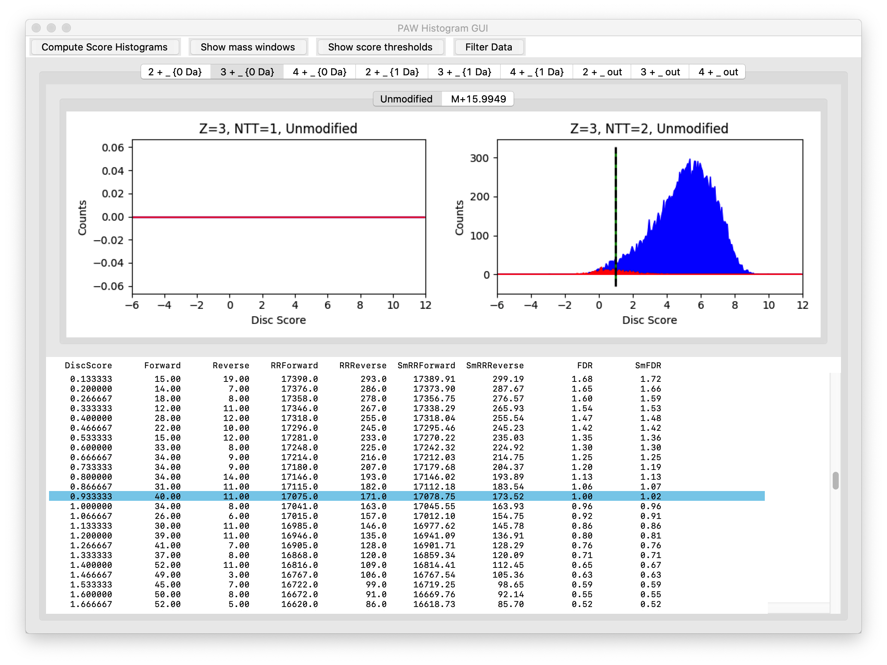
Conditional Scores for 3+
Target (blue), decoy (red)
Dotted line at 1% FDR
0-Da region
Unmodified PSMs
Notes:
These are the scores for unmodified 3+ peptides with a 0-Da deltamass. We have very few decoy matches for the 0-Da windows.

Slide 11

Conditional Scores for 3+
Target (blue), decoy (red)
Dotted line at 1% FDR
0-Da region
Oxidized Met PSMs
Notes:
These are the scores for the oxidized met 3+ peptides with a 0-Da deltamass.

Slide 12
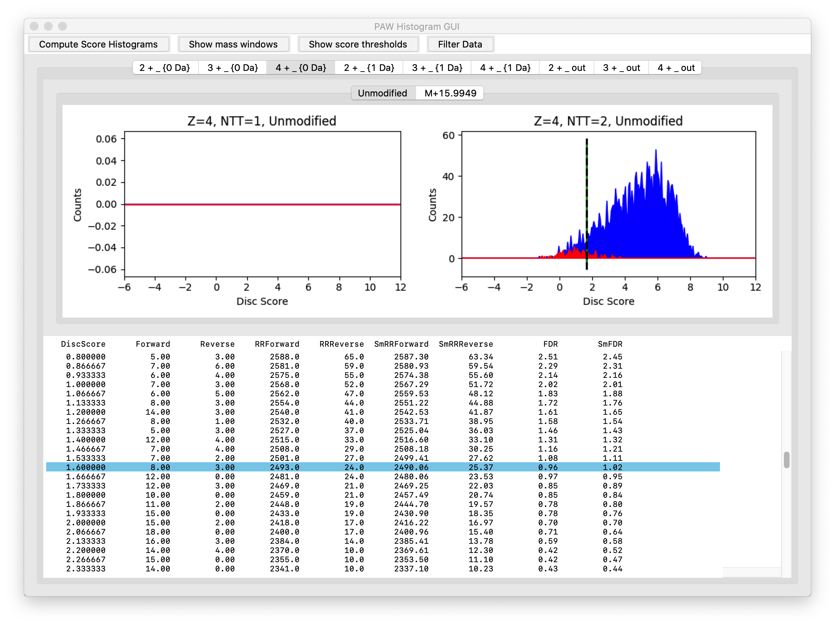
Conditional Scores for 4+
Target (blue), decoy (red)
Dotted line at 1% FDR
0-Da region
Unmodified PSMs
Notes:
These are the scores for the unmodified 4+ peptides with a 0-Da deltamass. We do not have many 4+ peptides with trypsin.

Slide 13
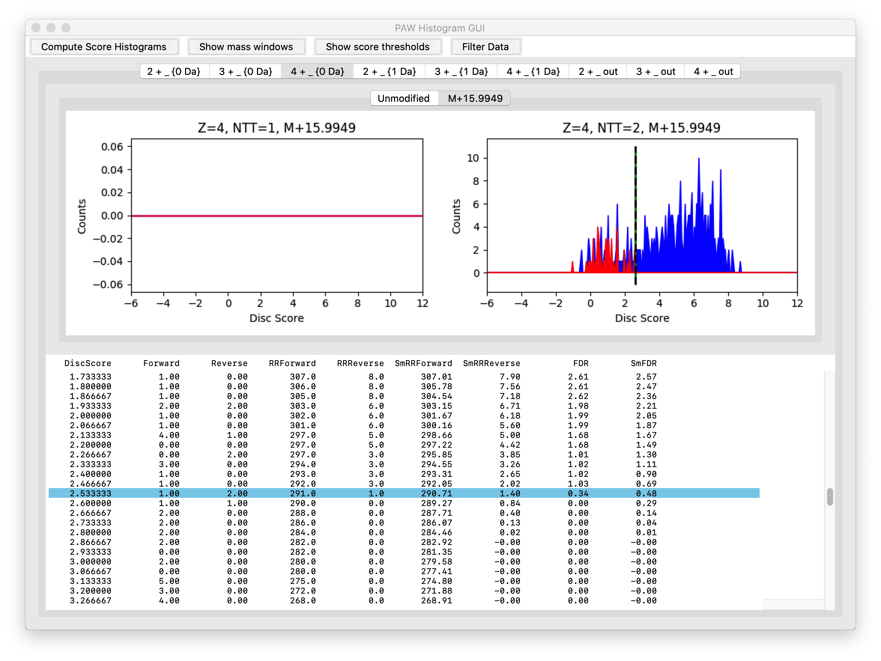
Conditional Scores for 4+
Target (blue), decoy (red)
Dotted line at 1% FDR
0-Da region
Oxidized Met PSMs
Notes:
These are the scores for the oxidized met 4+ peptides with a 0-Da deltamass.

Slide 14
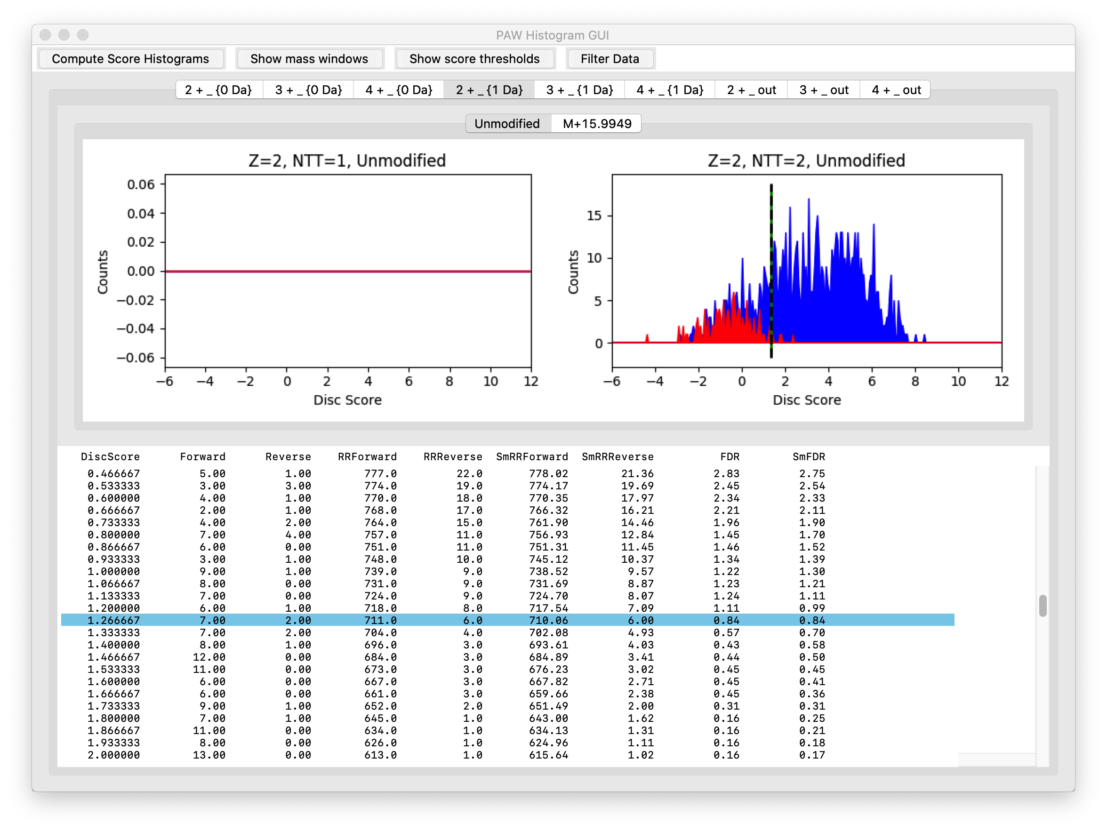
Conditional Scores for 2+
Target (blue), decoy (red)
Dotted line at 1% FDR
1-Da region
Unmodified PSMs
Notes:
The small 1-Da deltamass region is up next. These are the scores for the unmodified 2+ peptides with a 1-Da deltamass. We lump together the two peaks to get better statistics and to try and keep the number of histograms more manageable.

Slide 15
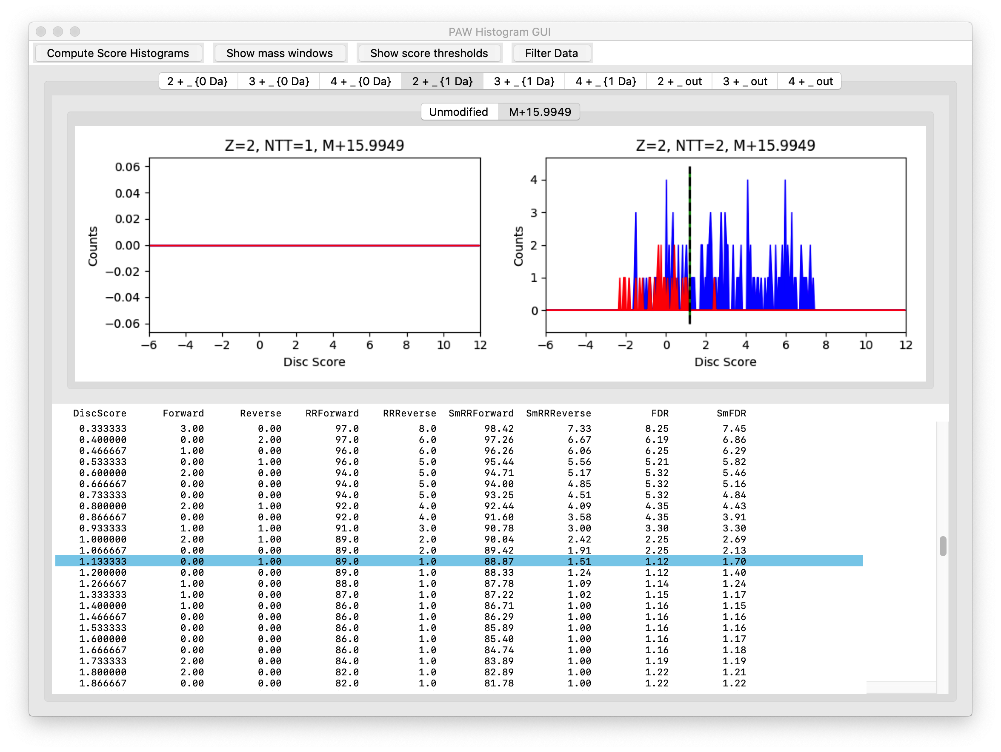
Conditional Scores for 2+
Target (blue), decoy (red)
Dotted line at 1% FDR
1-Da region
Oxidized Met PSMs
Notes:
These are the scores for the oxidized met 2+ peptides with a 1-Da deltamass.

Slide 16
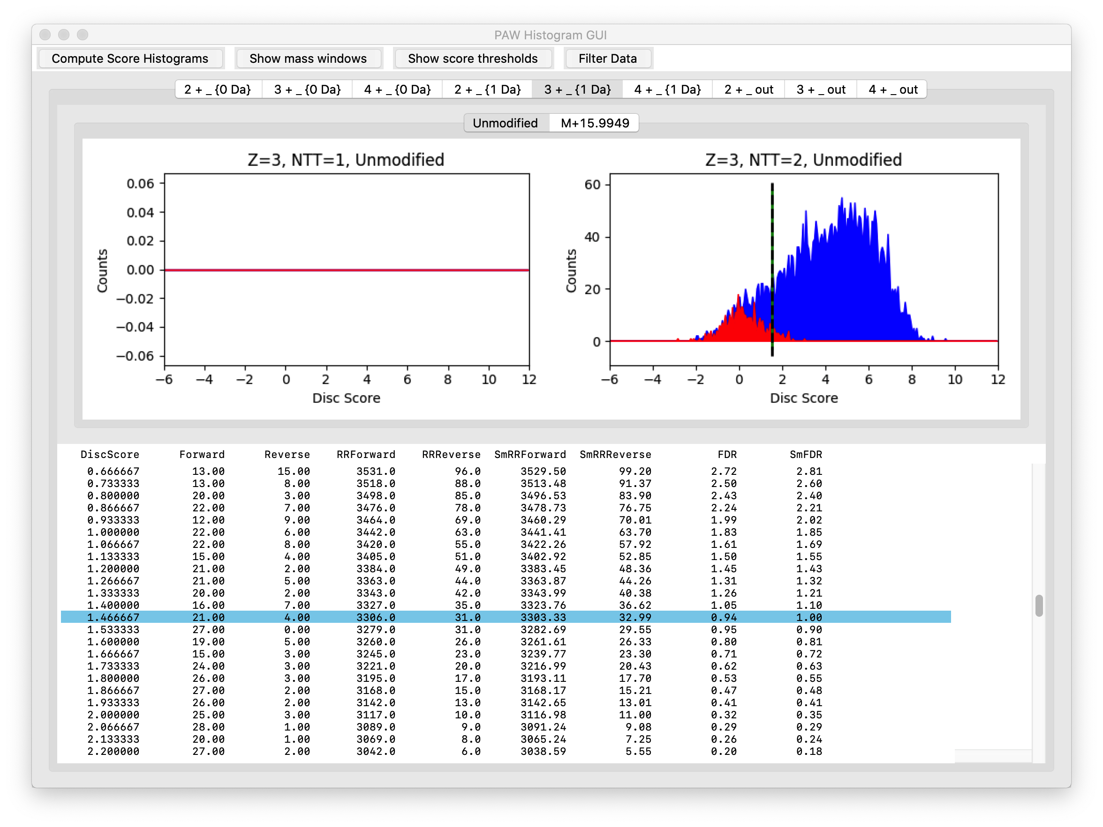
Conditional Scores for 3+
Target (blue), decoy (red)
Dotted line at 1% FDR
1-Da region
Unmodified PSMs
Notes:
These are the scores for the unmodified 3+ peptides with a 1-Da deltamass.

Slide 17
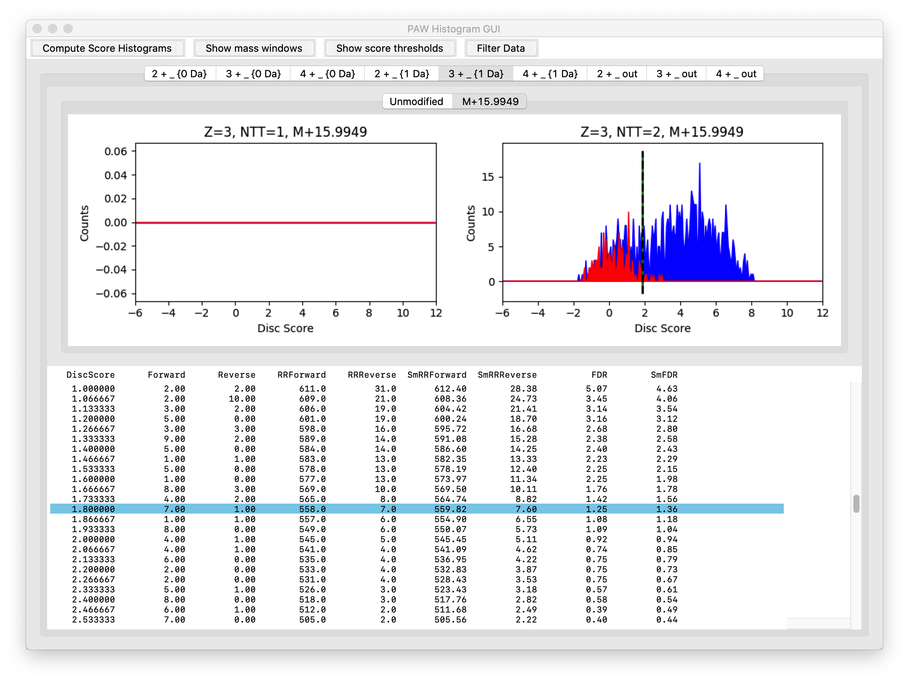
Conditional Scores for 3+
Target (blue), decoy (red)
Dotted line at 1% FDR
1-Da region
Oxidized Met PSMs
Notes:
These are the scores for the oxidized met 3+ peptides with a 1-Da deltamass.

Slide 18

Conditional Scores for 4+
Target (blue), decoy (red)
Dotted line at 1% FDR
1-Da region
Unmodified PSMs
Notes:
These are the scores for the unmodified 4+ peptides with a 1-Da deltamass.

Slide 19
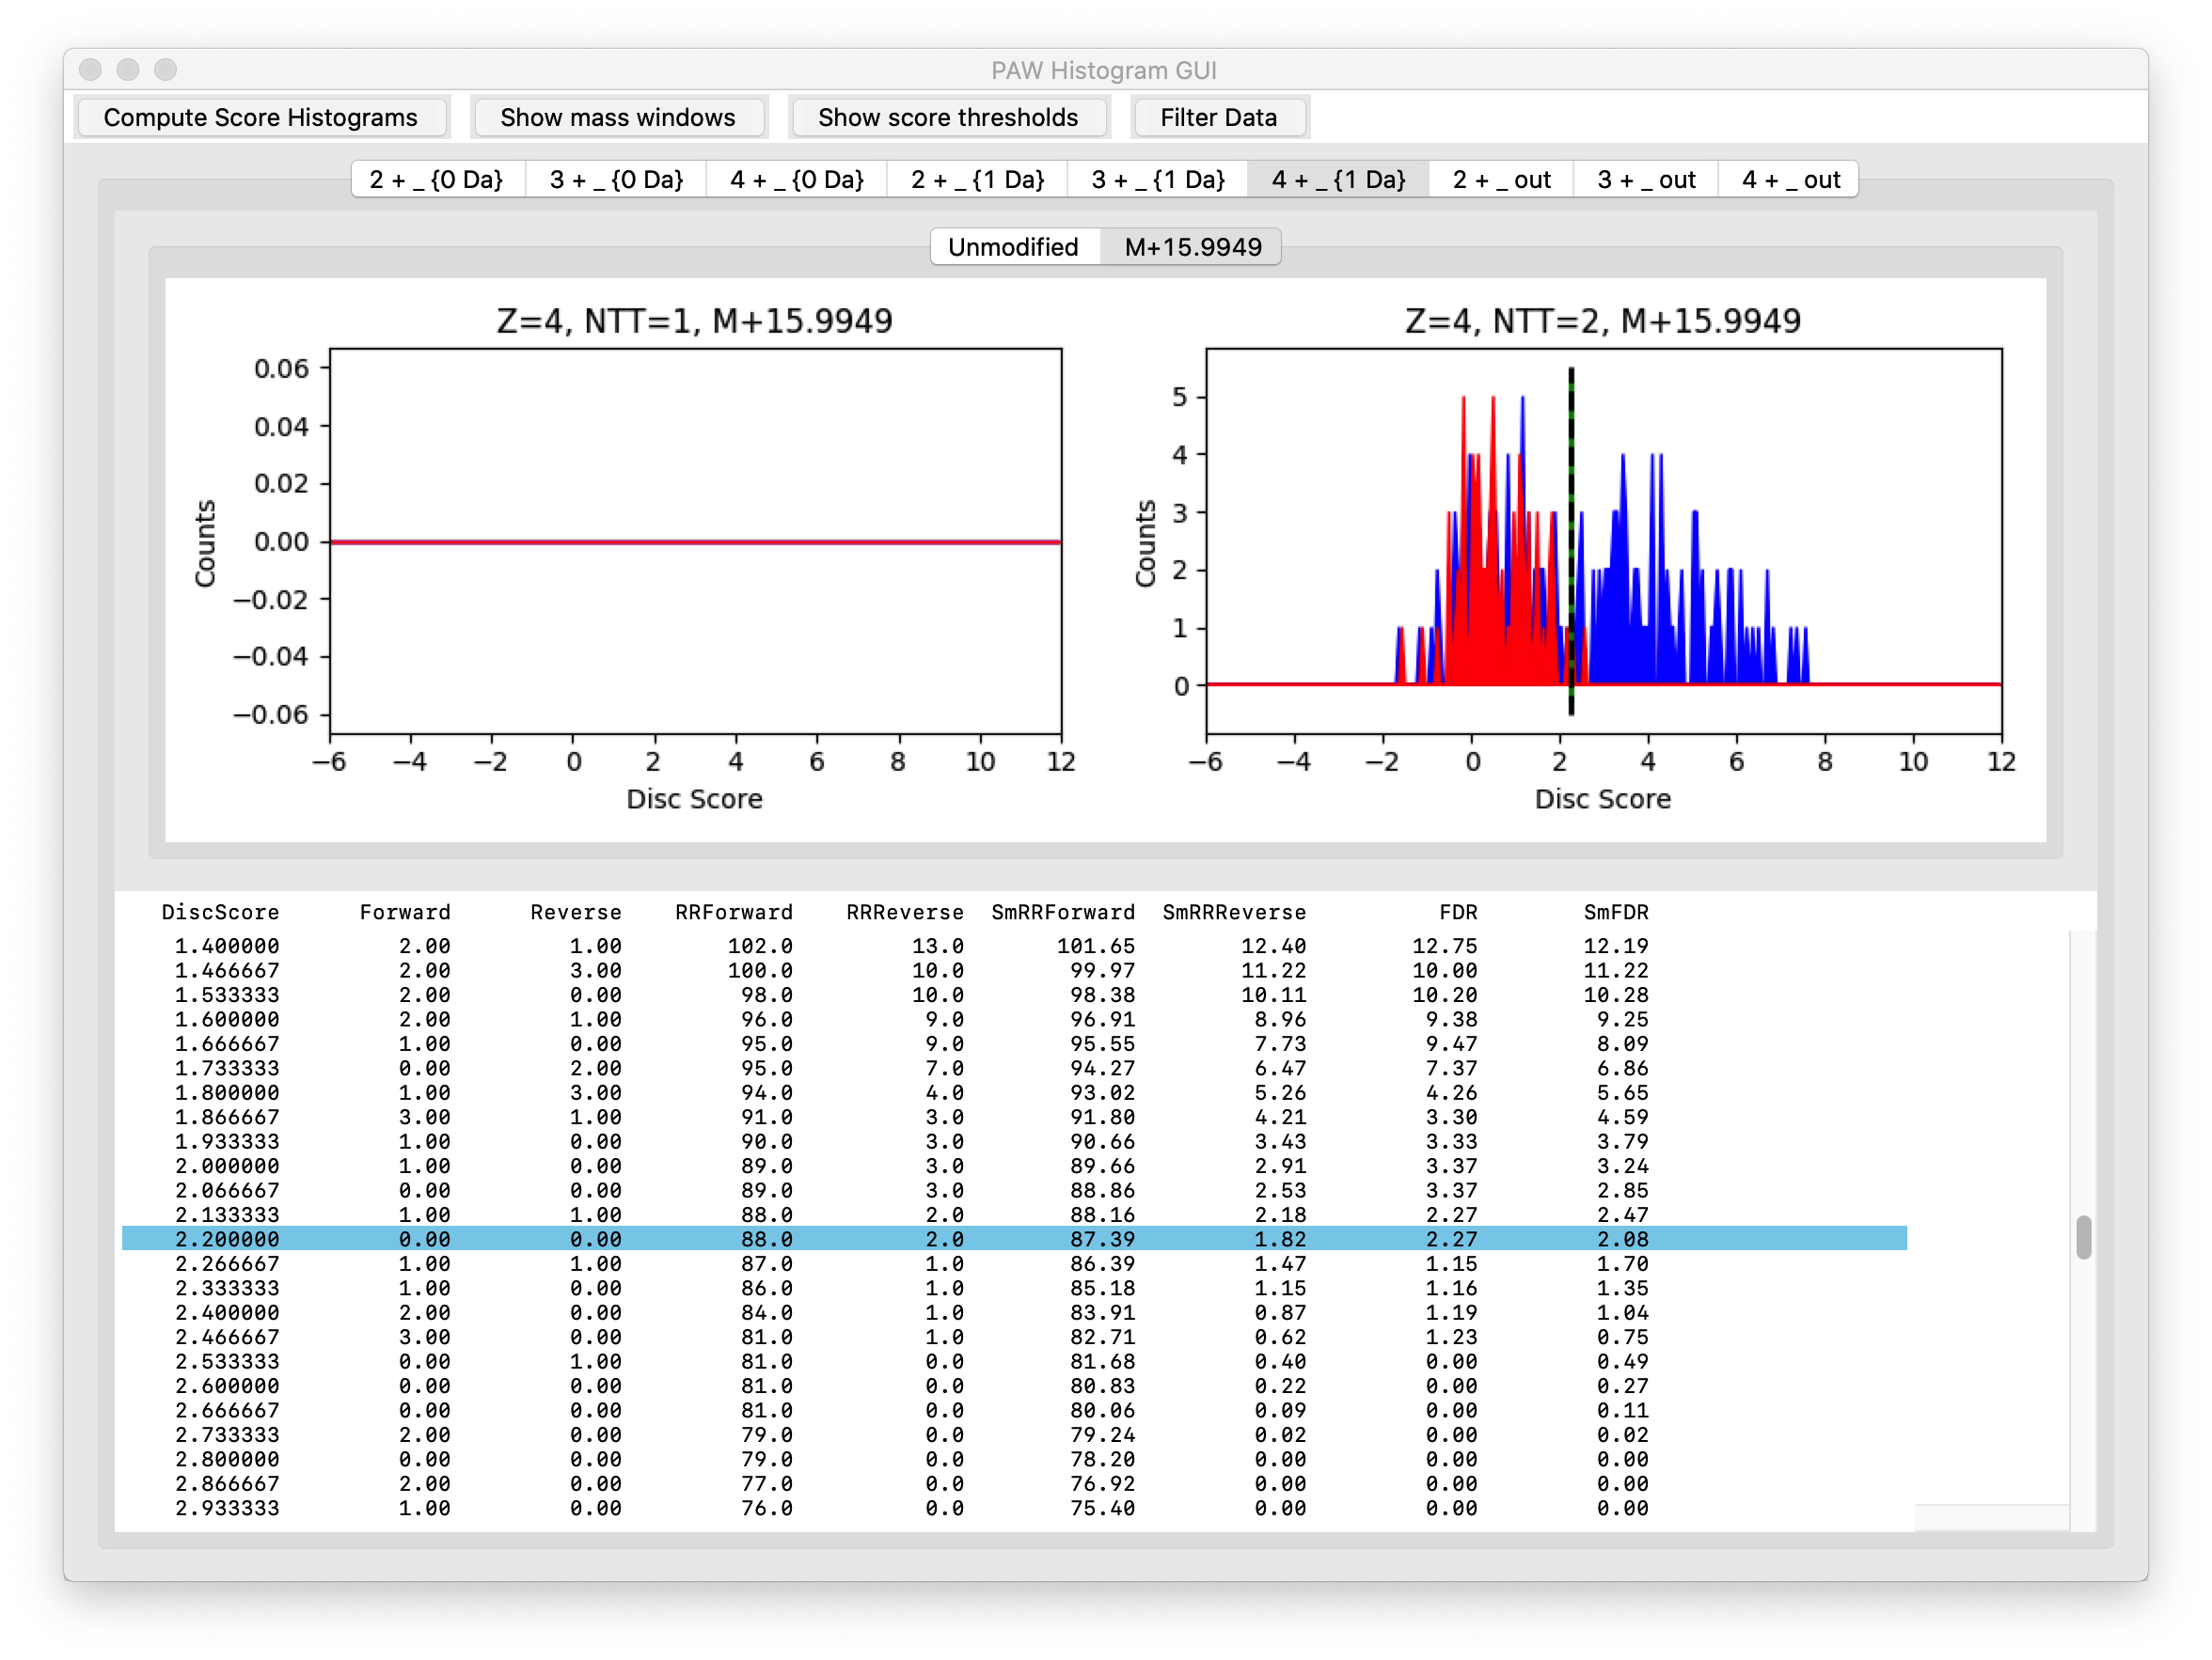
Conditional Scores for 4+
Target (blue), decoy (red)
Dotted line at 1% FDR
1-Da region
Oxidized Met PSMs
Notes:
These are the scores for the oxidized met 4+ peptides with a 1-Da deltamass.

Slide 20
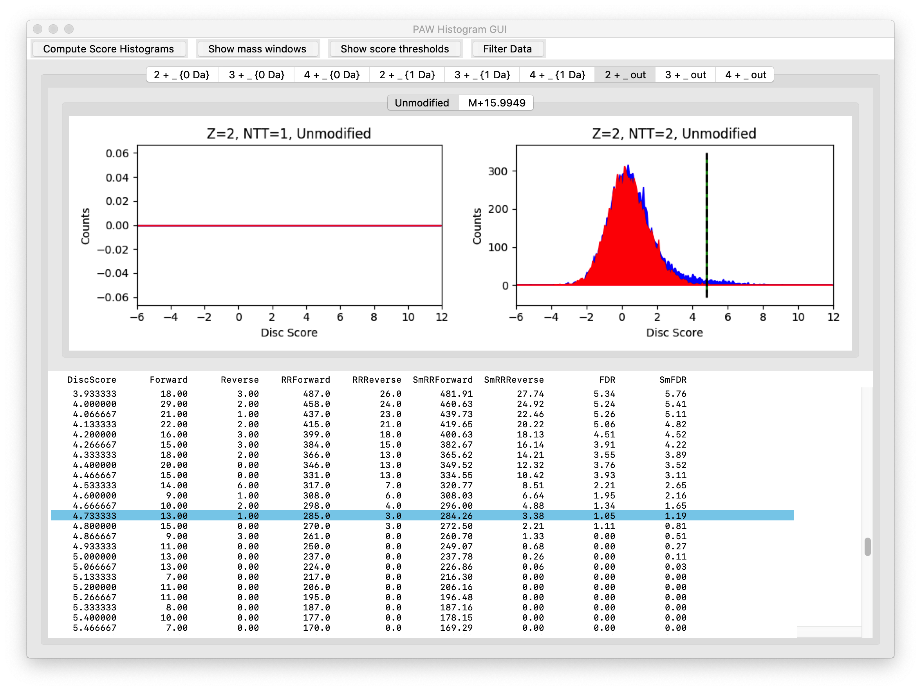
Conditional Scores for 2+
Target (blue), decoy (red)
Dotted line at 1% FDR
No accurate mass region
Unmodified PSMs
Notes:
There are often correct matches that do not have accurate deltamasses. What fraction of the data might fall into this category depends on a lot of factors including the instrument method. These matches would be lost with narrow parent ion mass tolerance (10-20 ppm) search settings. These are the unmodified 2+ peptides that did not have a deltamass inside either the 0-Da window or the 1-Da window.

Slide 21
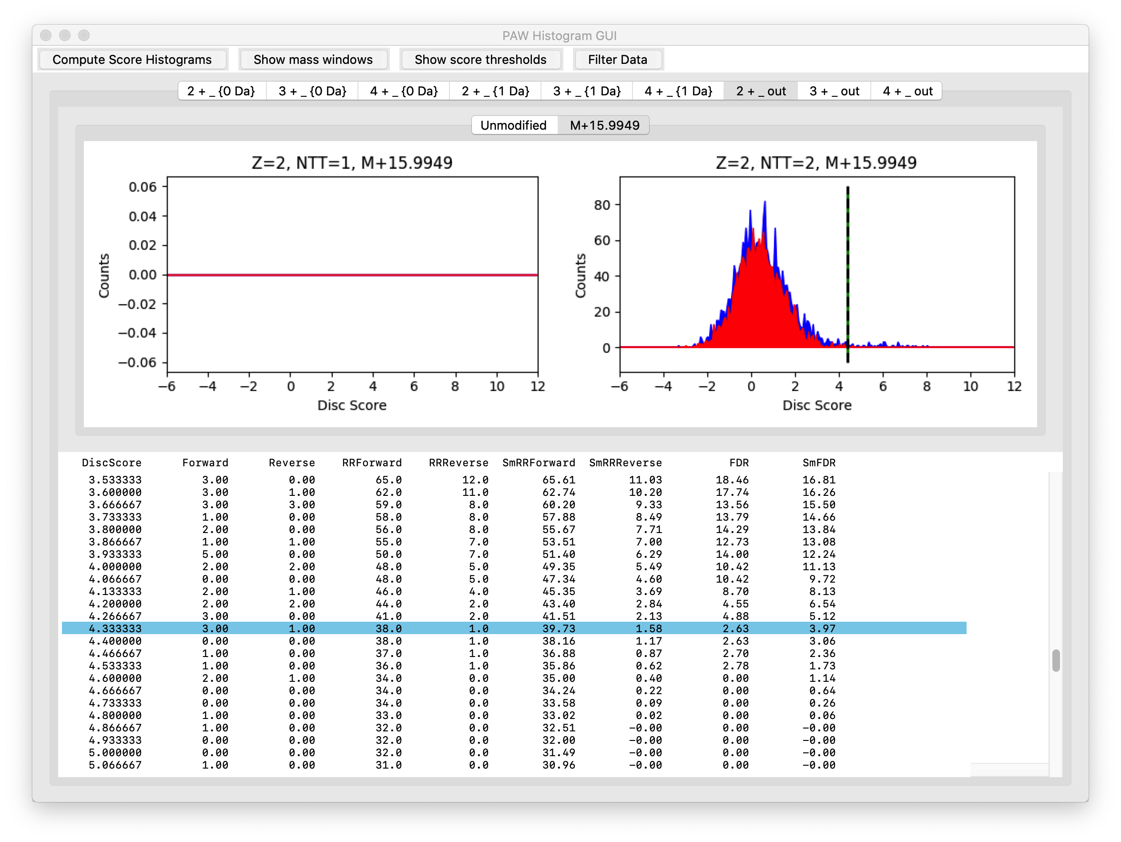
Conditional Scores for 2+
Target (blue), decoy (red)
Dotted line at 1% FDR
No accurate mass region
Oxidized Met PSMs
Notes:
These are the oxidized met 2+ peptides that did not have a deltamass inside either the 0-Da window or the 1-Da window.

Slide 22
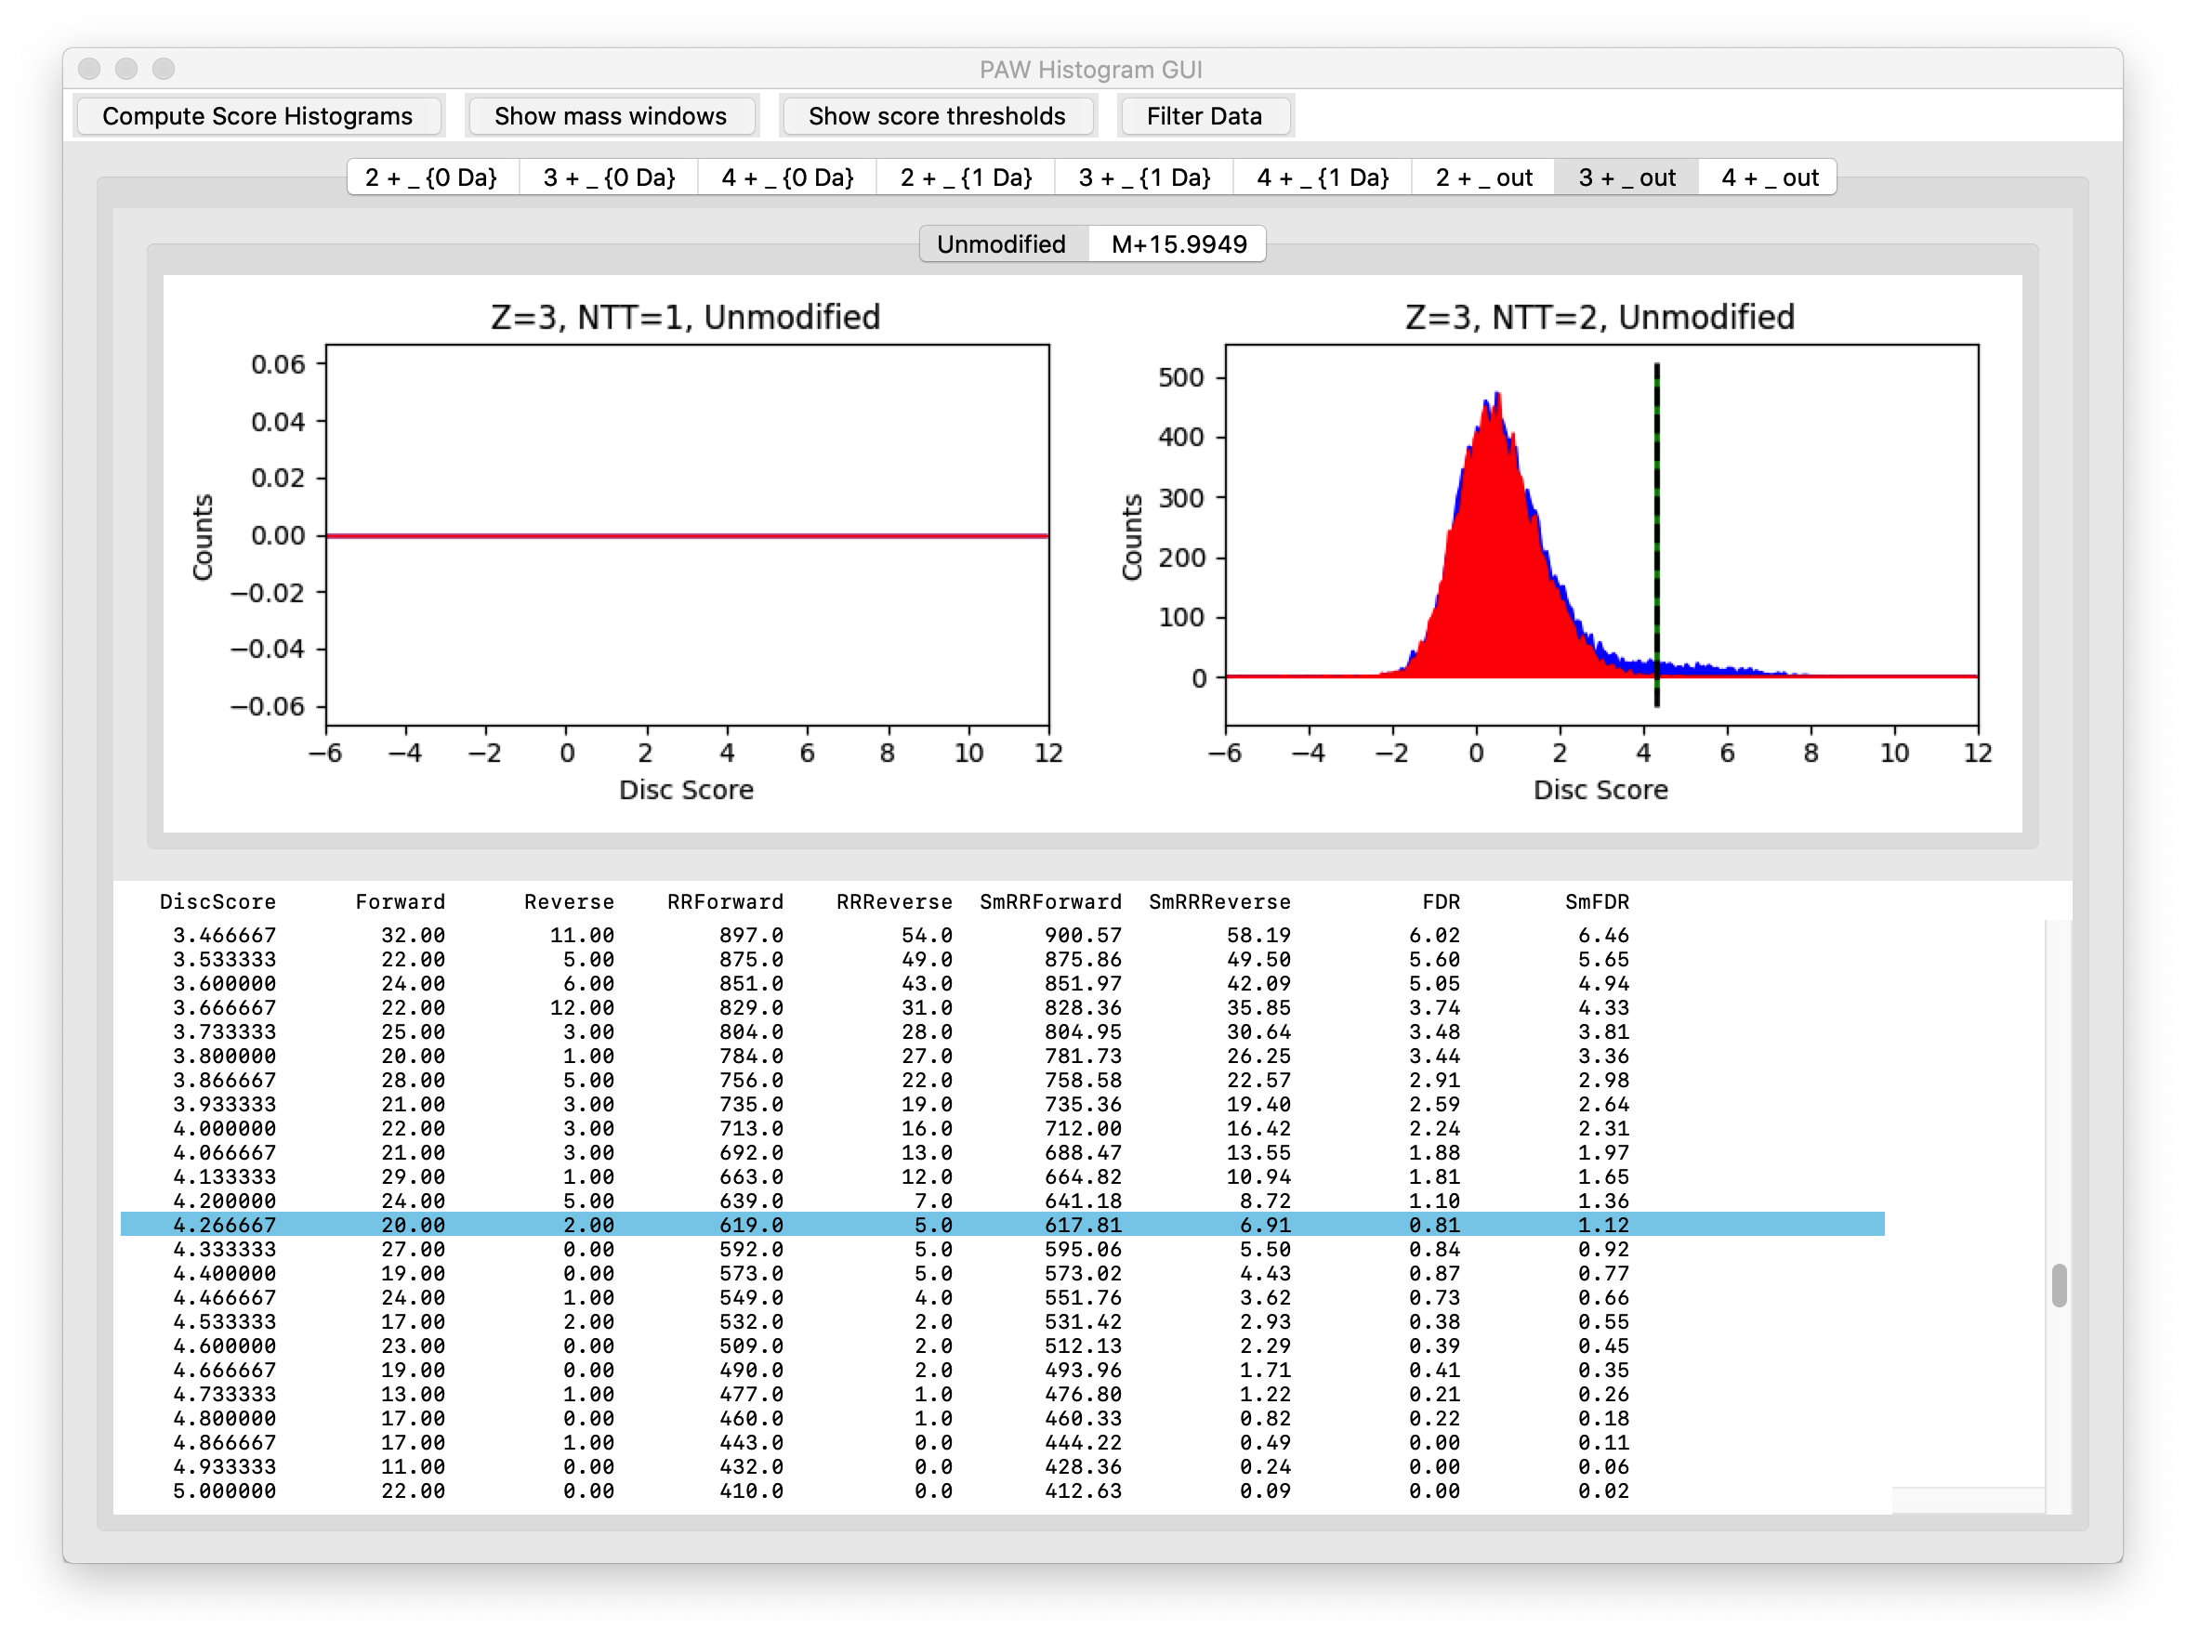
Conditional Scores for 3+
Target (blue), decoy (red)
Dotted line at 1% FDR
No accurate mass region
Unmodified PSMs
Notes:
These are the unmodified 3+ peptides that did not have a deltamass inside either the 0-Da window or the 1-Da window.

Slide 23
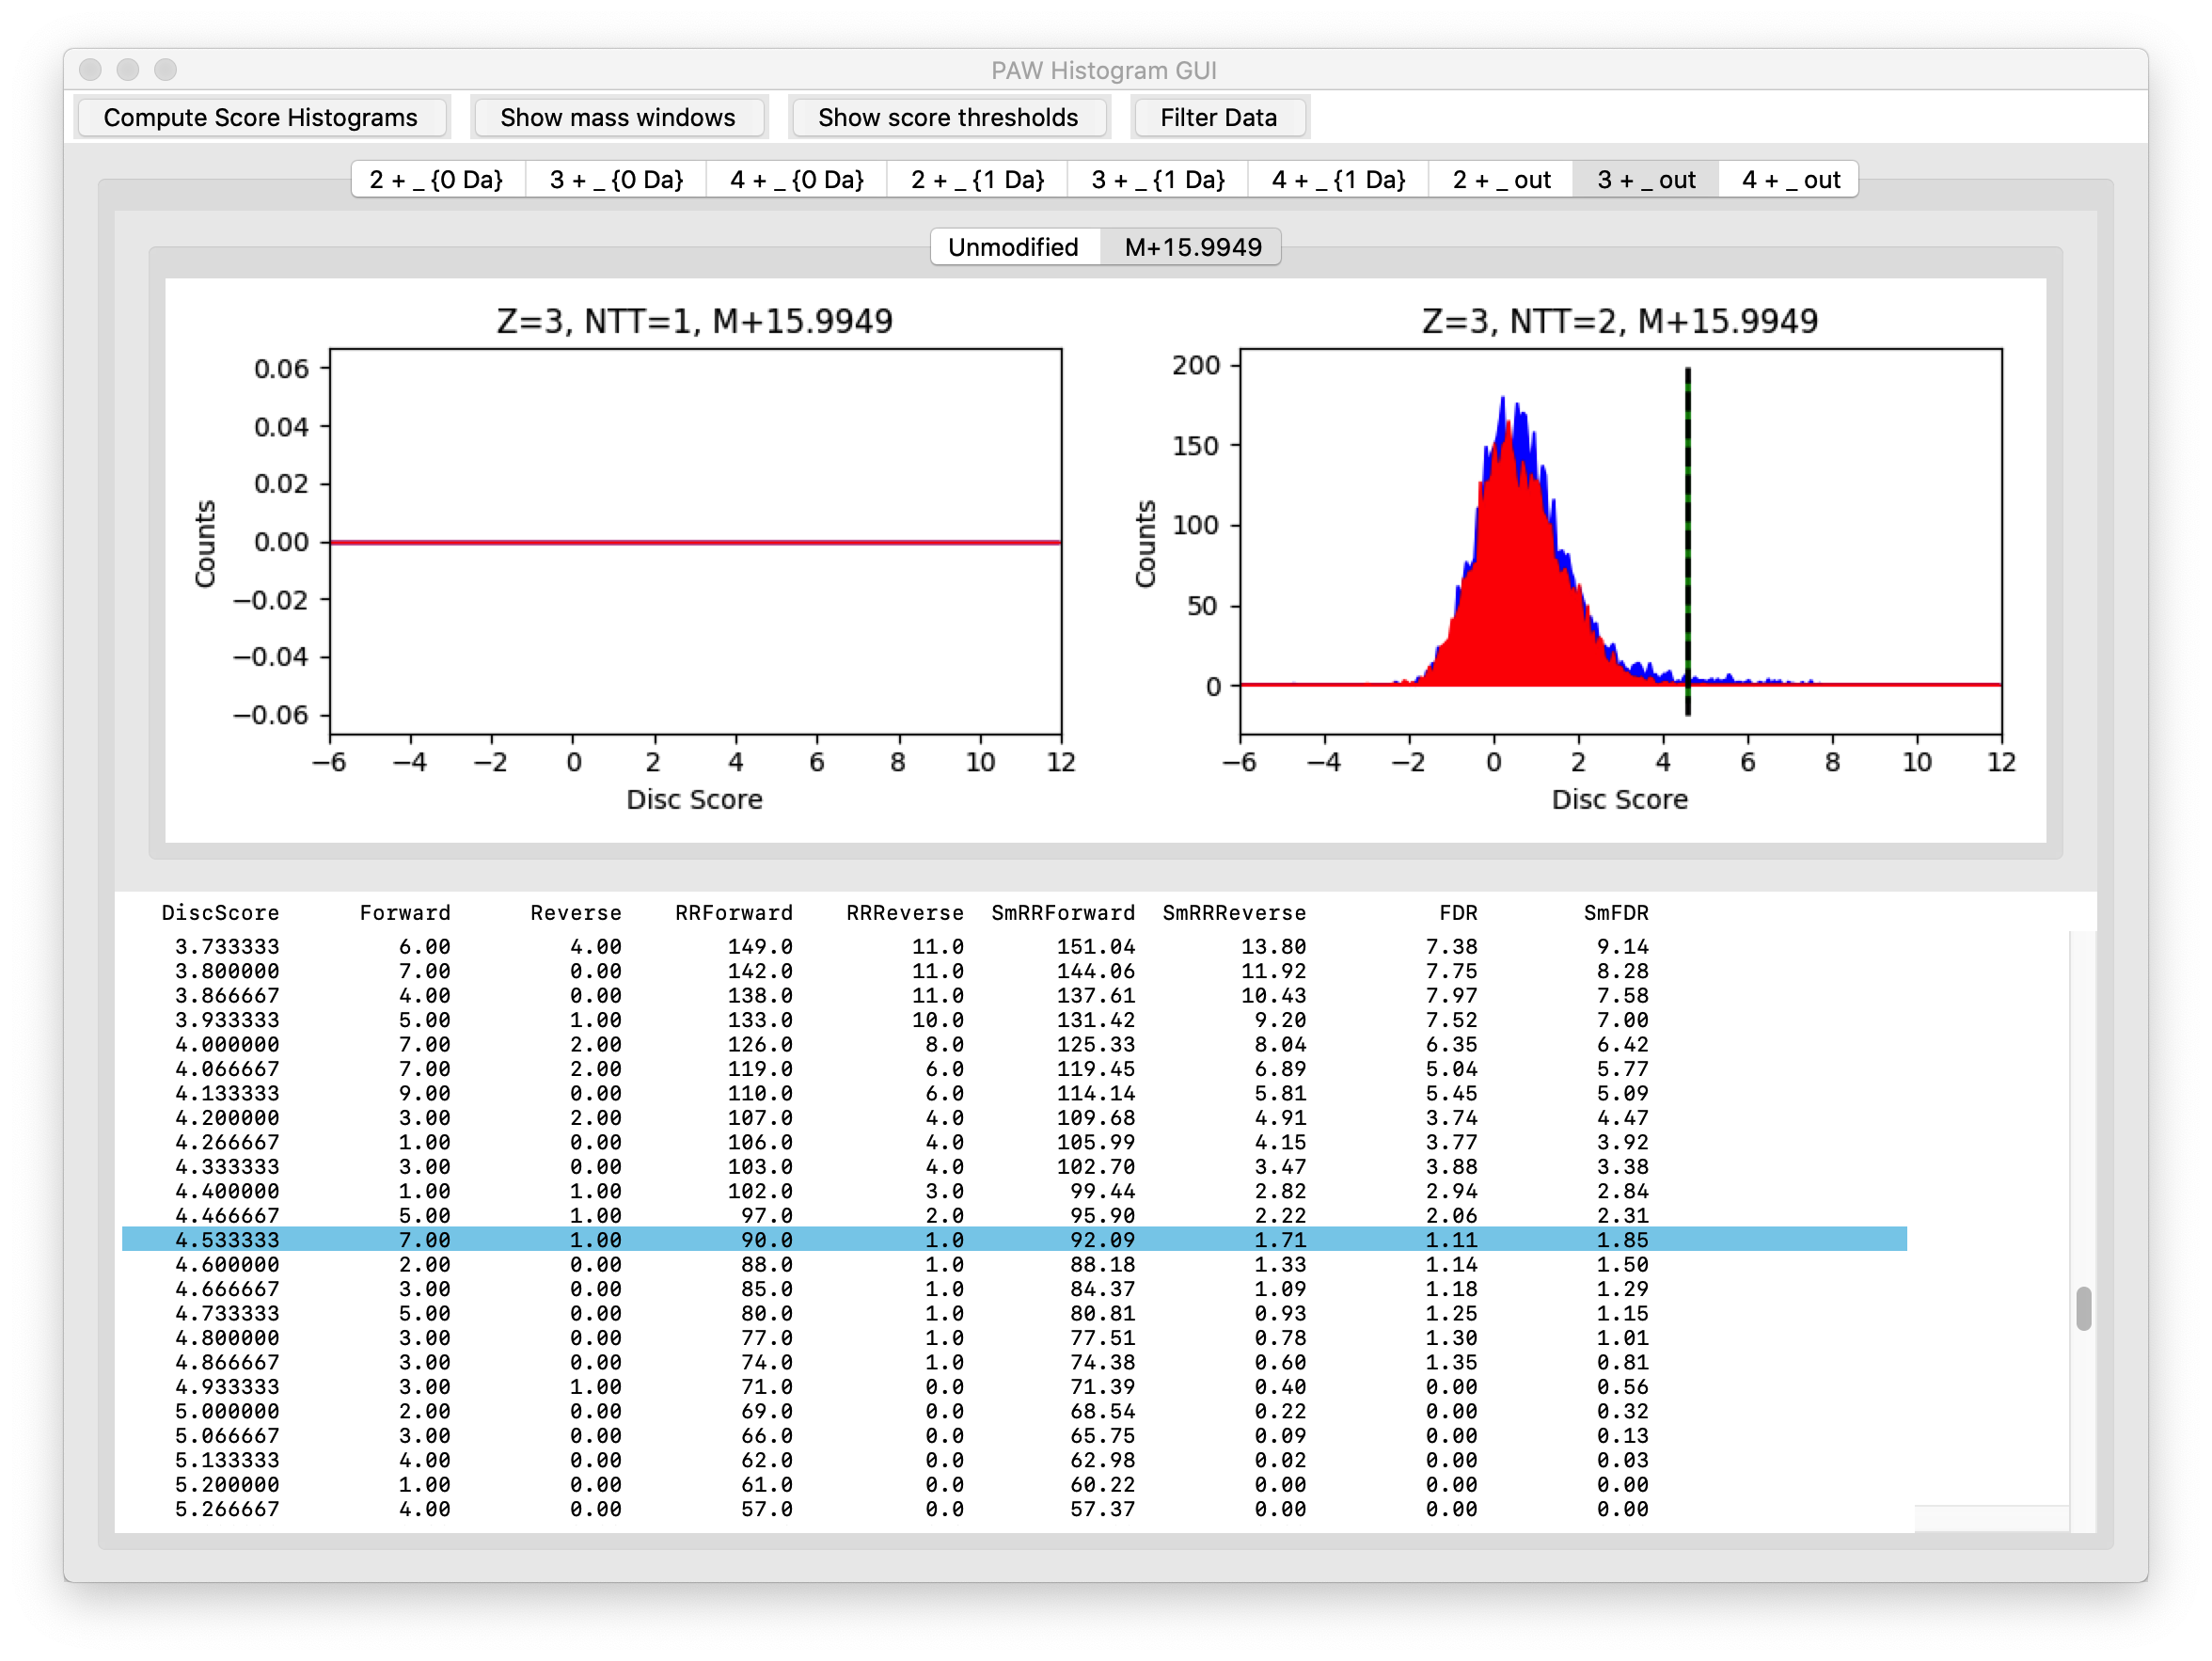
Conditional Scores for 3+
Target (blue), decoy (red)
Dotted line at 1% FDR
No accurate mass region
Oxidized Met PSMs
Notes:
These are the oxidized met 3+ peptides that did not have a deltamass inside either the 0-Da window or the 1-Da window.

Slide 24
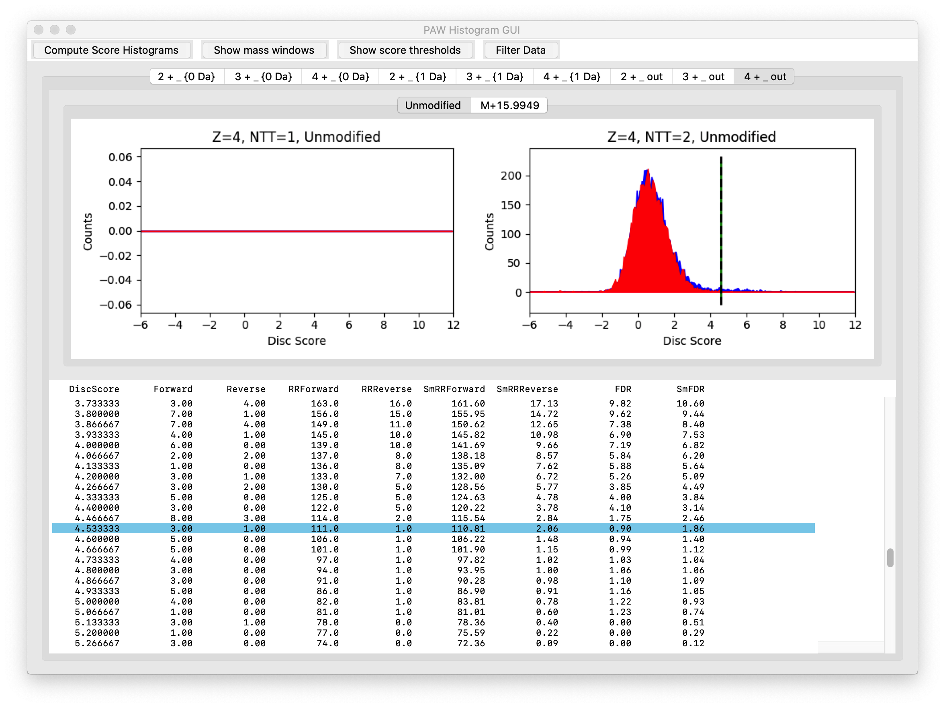
Conditional Scores for 4+
Target (blue), decoy (red)
Dotted line at 1% FDR
No accurate mass region
Unmodified PSMs
Notes:
These are the unmodified 4+ peptides that did not have a deltamass inside either the 0-Da window or the 1-Da window.

Slide 25
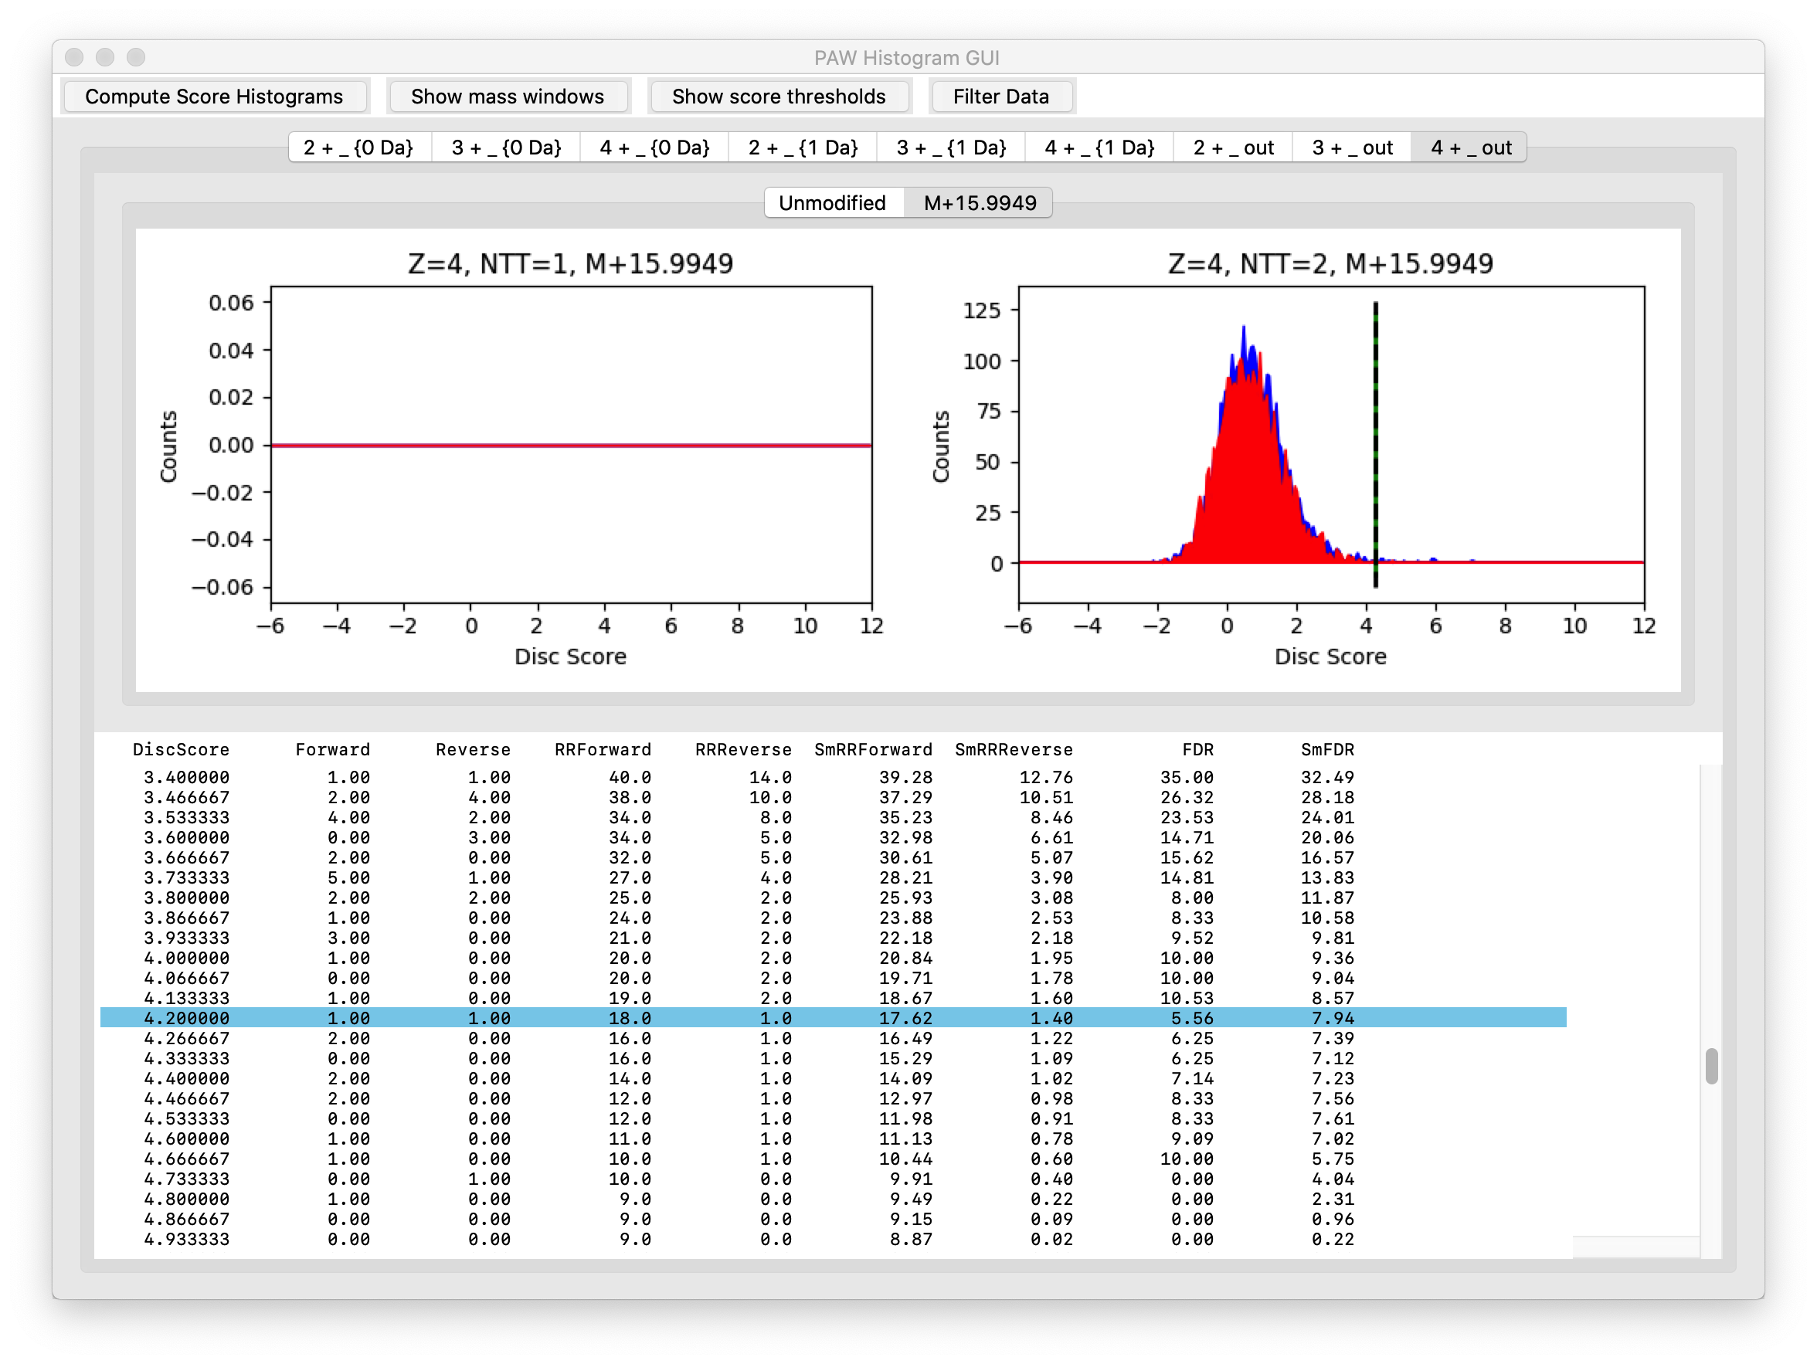
Conditional Scores for 4+
Target (blue), decoy (red)
Dotted line at 1% FDR
No accurate mass region
Oxidized Met PSMs
Notes:
These are the oxidized met 4+ peptides that did not have a deltamass inside either the 0-Da window or the 1-Da window. Collectively, we recovered a little over 1,000 additional target matches (from 5 LC runs) from this outside windows deltamass peptide class.

Slide 26
Fusion data processed separately
Fusion data was from OHSU Core 2014 Fusion instrument
Data from March 2020
Similar 1% FDR cutoffs
Same Comet parameters
Notes:
The original Fusion data from this single LC run was re-processed with the same parameters that were used for the Eclipse processing.

Slide 27
Dataset acquisition, FDR, and quant scans
Dataset | Acquired MS2 Scans | 1% FDR Filtered Scans | Identification Rate
Fusion SPS MS3 | 19,269 | 9,042 | 46.9%
Eclipse SPS MS3 | 27,201 | 8,598 | 31.6%
Eclipse SPS MS3 with RTS | 39,563 | 10,963 | 27.7%
Dataset | Scans with no or low reporter ions | Net scans with reporter ions | Total scans with usable reporter ions (unique)
Fusion SPS MS3 | 1,088 | 7,954 | 7,080
Eclipse SPS MS3 | 510 | 8,088 | 7,154
Eclipse SPS MS3 with RTS | 2,341 | 8,622 | 7,780
Notes:
These are the data processing summary statistics for the three platform/methods being compared. Complicated methods like SPS MS3 have many parameters that affect cycle times and data signal-to-noise. We had fewer acquired MS2 scans in a 2-hour run with our Fusion settings. However, we had a pretty high identification rate of 47%. The real time search skips the time consuming MS3 scan in the Orbitrap for MS2 scans that should not yield confident PSMs. This frees up the instrument to acquire more scans in a given time. Despite the vote of confidence from the real time search scoring, we had the lowest ID rate for the Eclipse with RTS.
The point of TMT experiments is not just identification but also quantification. The bar is higher for quantitative data than for identification data. The PAW pipeline tests individual MS3 scans against a low intensity cutoff. A trimmed mean is computed and tested. If the test fails, the reporter ions for than scan are zeroed out. The MS2 scan is retained for identification and protein inference reasons. This means not every scan passing the FDR cutoff will have reporter ion signals. For the RTS data, the MS2 scans that did not trigger an MS3 scan are also in the data mix. Not all scans with reporter ions are usable for quantification in shotgun experiments. Peptides that map to multiple proteins (in the proper context) have ambiguous information content and cannot be used. We routinely use minimally redundant UniProt canonical reference protein databases and employ an extended parsimony protein grouping step to maximize the usable peptides for quantification. The last column of the bottom table are the final numbers and the most accurate for comparisons between platform/methods.

Slide 28
Identification versus quantification
All PSMs are needed for protein inference
Some of the PSMs may not have associated reporter ions
This is especially true for real time search acquisition
Lists of identified peptides and proteins may be larger than lists of quantifiable peptides and proteins
Dataset | Number of unique peptides | Number of identified proteins (2 peptides/protein) | Number of quantifiable proteins (kind of)
Fusion SPS MS3 | 6,788 | 822 | 742
Eclipse SPS MS3 | 6,224 | 823 | 753
Eclipse SPS MS3 with RTS | 7,486 | 972 | 900
Notes:
I find the PSM counts to be the best numbers to use to see the differences. We are usually reporting proteins but how a given number of PSMs produce a list of proteins depends on many factors beyond the instrument performance; such as, type of samples, the types of proteins in the samples, organism being studied, choice of protein database, protein inference algorithm, and any protein ranking/cutoff heuristics. As mentioned, we need to keep PSMs that do not have sufficiently intense reporter ions to correctly infer the proteins. When we count peptides and proteins, those numbers are based on all PSMs. The PAW pipeline does not track quantifiable proteins per se. I did make some effort to count those for the last column in this analysis.

Slide 29
Reporter ion totals are different
Remove contaminants and decoys
Protein total intensity is sum from “unique” PSMs
Grand totals are sums of average protein intensities across channels
Dataset | Grand Total Intensity
Fusion SPS MS3 | 200,869,105
Eclipse SPS MS3 | 1,095,741,498
Eclipse SPS MS3 with RTS | 741,015,972
Notes:
The intensities of individual reporter ions depend on many things: sample load, instrument tune, instrument cleanliness, HPLC performance, data acquisition settings, etc. This TMT labeling includes two identical reference channels (it was part of a larger 2-plex experiment). We will use those later to perform internal reference scaling (IRS) and get all of the data on a common scale. We can look at the general magnitude of the reporter ions before any normalizations to see how the data differ. We see lower intensity values for the Fusion, as might be expected. Interestingly, we have the largest values for the plain SPS MS3 method on the Eclipse. Without detailed instrument setting, it is hard to know if this has any significance. Different AGC targets or ion fill times might have been used.

Slide 30
Coefficient of Variance (CVs in %) by anticoagulant for each platform/method.
Notes:
One of the benefits of isobaric labeling is the reproducibility of the measurements. Technically, that is only true if the data is processed correctly. There are multiple normalization steps involved in these analyses and the natural reporter ion intensity scale need to be kept. When all of that is done correctly, the the distribution of protein CVs by biological condition is an excellent performance metric. Here we have the CV distributions for the 3 anticoagulants by platform/method. The higher sensitivity Eclipse Orbitrap Tribrid compared to the Fusion is reflected in higher quality reporter ion signals. The median CVs and spread in the CV distributions are improved for the Eclipse. The real time search method seems to further improve the data.

Slide 31
CVs for all 9 channels by platform/method
Notes:
We know that the choice of anticoagulant did not change protein expression very much. We can lump all the anticoagulant data together and compute an overall CV distribution by platform/method. The difference between the Fusion and the newer Eclipse is now a little more obvious.

Slide 32
Median protein total intensity CVs (%)
Platform/Method | ACD samples | EDTA samples | Heparin samples | All samples
Fusion SPS MS3 | 10.5% | 8.7% | 11.8% | 12.3%
Eclipse SPS MS3 | 8.2% | 7.2% | 9.5% | 9.4%
Eclipse Real Time Search | 7.2% | 6.1% | 8.6% | 7.9%
Notes:
Here are the median CVs (%) associated with the distributions in the previous two slides. These are three different human biological subject samples; these are not cell cultures. Platelets, with careful preparation, have rather low CVs compared to other human subject samples that we have worked with over the years in the OHSU core. These are all SPS MS3 measurements, so the CVs are not small because of compressed dynamic range for reporter ions that is present in MS2-based methods.

Slide 33
How similar are ACD biological replicates to each other by platform/method?
Notes:
We can use multi-panel scatter plots to see how similar each biological replicate is. These are the ACD anticoagulant samples for the three platform/methods.

Slide 34
How similar are EDTA biological replicates to each other by platform/method?
Notes:
These are the EDTA anticoagulant samples for the three platform/methods.

Slide 35
How similar are Heparin biological replicates to each other by platform/method?
Notes:
These are the Heparin anticoagulant samples for the three platform/methods. In all anticoagulants, we have more scatter in the Fusion data, particularly for low intensities. The platelets from one subject (S3) had some different response to heparin that was not seen in the other two anticoagulants. Subjects S1 and S4 had very similar intensities (lower left scatter plots in each panel).

Slide 36
Are there protein expression changes caused by anticoagulant (ACD versus EDTA)?
Notes:
Statistical testing was done to compare the anticoagulants to each other. This does not make any sense for this pre-run sample. The original experiment performed at OHSU used 18 first dimension fractions in a scaled-up experiment with two 11-plexes. Over 3000 proteins were profiled in that experiment (complete analysis in progress). Here we are mostly qualitatively comparing plots between platform/methods. These are the data from the ACD and EDTA samples (at 1-hour).

Slide 37
Are there protein expression changes caused by anticoagulant (ACD versus Heparin)?
Notes:
These are the data from the ACD and Heparin samples (at 1-hour).

Slide 38
Are there protein expression changes caused by anticoagulant (EDTA versus Heparin)?
Notes:
These are the data from the EDTA and Heparin samples (at 1-hour). For this limited experiment, we do not have many, if any, real differential expression changes. We have one heparin treated sample with some proteins that changed in abundance. That alters some average protein expression levels and that comes with some high variance. We have a few proteins with more than 2-fold expression changes, but most are not statistically significant.

Slide 39
IRS used to put intensities on same scale
Notes:
Internal reference scaling makes the most sense conceptually to take data acquired on one instrument at one time from multi-plexes and combine them into one seemingly larger plex experiment. However, the same channels in a TMT plex are still the same samples no matter what instrument is used or when it was used. We can actually combine the OHSU Fusion data with the San Jose Thermo Eclipse data using the pooled reference channels. This puts all three platform/method datasets on the same intensity scale for direct comparisons. We see that the intensity distributions are very well matched after IRS and TMM normalization, with the boxplots all in excellent horizontal alignment. Keep in mind that all scaling of the 9 biological samples in each of the three datasets were independent. The scaling of each plex was based only on the common reference channels. We can check how the samples cluster. The two Eclipse datasets are nearly identical (blue and green). There is more spread in the Fusion data and it is not as similar to the Eclipse data as the two Eclipse runs are to each other. The Fusion is to the left (red) and the Eclipse data are to the right (blue/green). The top-to-bottom pattern is similar between both instruments. S3 heparin is at the top and S1 ACD is at the bottom.

Slide 40
Notes:
We know from many of the previous slides that these 9 biological samples are not very different from each other. We can average the intensities for all nine samples for each platform/method and compare that by platform/method (this gives us nice large plots). This is pretty amazing. We have data from two different Orbitrap Tribrid instruments (two generations apart). We have two labs (OHSU and Thermo San Jose), we have two LC systems, we have two different technicians, we have two different dates, and we have two different data acquisition methods (for the Eclipse instrument). The Eclipse data is superb. The Fusion data has some warts but is still surprisingly good. The Fusion was a pretty successful first-generation instrument. The degree of complexity in these instruments is quite high. Adding the additional complexity of the real time search to the complexity of the Tribrids did not give me much confidence before starting this analysis. I am not very susceptible to manufacturer and major lab hype for these sorts of things. I see minor to major flaws in almost every published paper I read these days (I know, I am old and cranky). I don’t believe anything until I test it. I have to say that I think the real time search works well.

Slide 41
Summary and conclusions
More sensitive Eclipse produces higher quality data
Fusion variability worse at lower abundances
Real time search offered some improvements
Need to compare multiple metrics to get clear picture of platform and method differences
This comparison is for one sample and your mileage may vary
I would pick a new Eclipse over a 6-year old Fusion…
Notes:
I expected a new instrument to outperform a six-year-old instrument and that was the case. We knew that the Fusion was less sensitive for the multi-stage isolations and we have compensated with scaled up experiments (always 9 to 18 fractions). Real time search actually works, and the RAW files are almost the same as from the regular SPS MS3 method. We did not see anything approaching a factor of 2 improvement, at least not for this sample. There was about a 9% gain compared to the regular SPS MS3 method on the Eclipse. Median CVs and data scatter were better, and the proteome sampling depth was quite a bit better. There are many comparison metrics to consider simultaneously to get an accurate picture of the similarities and differences.

